Slide 1
Matter flows

Slide 2
Matter Flows
Matter flows through ecosystems linking them together. The flow of matter involves transfers and transformations.
Carbon Cycle
Nitrogen Cycle

Slide 3
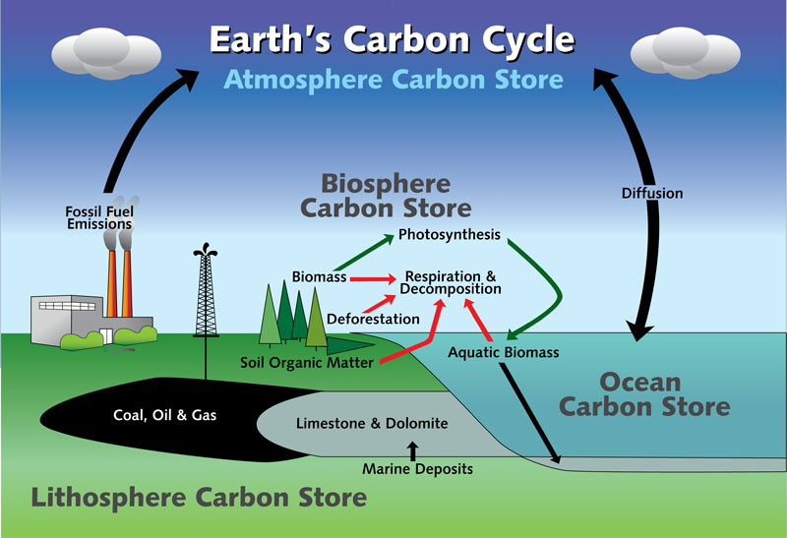

Slide 4
Carbon Cycle
Carbon flows through ecosystems through feeding, death and decomposition, photosynthesis, respiration, dissolving, and fossilization.
Carbon is stored in organisms and forests, the atmosphere, soil, fossil fuels, and in the oceans.
Places where carbon is stored are called Carbon Sinks
The oceans are the largest carbon sinks, holding many times more carbon than all the forests on earth combined.
Climate change is affecting how much carbon the ocean can hold.

Slide 5
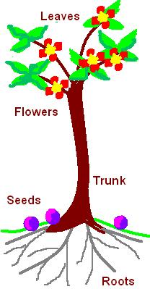
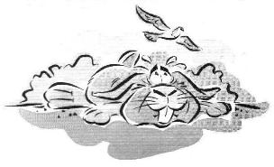
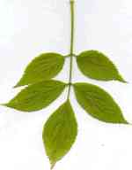
Nitrogen in
the air
Copy all!
nitrogen fixing plant
e.g pea, clover
animal protein
plant made
protein
dead rabbit
dead plants & animals
urine & faeces
root nodules
(containing nitrogen
fixing bacteria)
denitrifying
bacteria
decomposition by bacteria & fungi
nitrates absorbed
nitrates
ammonia
bacteria
nitrites
bacteria
(nitrifying bacteria)

Slide 6
Nitrogen Cycle
Nitrogen flows include nitrogen fixation by bacteria and lightning, absorption, assimilation, consumption, excretion, death, decomposition, and denitrification by bacteria in water-logged soils.
Nitrogen is stored in organisms, soil, fossil fuels, atmosphere, and bodies of water.
Places where nitrogen is stored are called Nitrogen Sinks

Slide 7
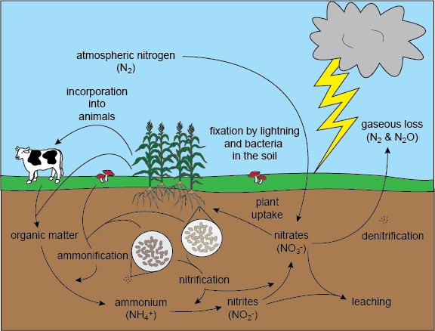

Slide 8
Human Impact on Energy Flows
Human activities such as burning of fossil fuels, deforestation, urbanization, and agriculture impact energy flows as well as the carbon and nitrogen cycle.
How does the burning of fossil fuels or deforestation affect the carbon cycle?
How could urbanization and agriculture affect either the carbon cycle or nitrogen cycle?
Take 5 minutes to write down your thoughts

Slide 9
To Do: Calculating Productivity
To do Page 67 of Course Companion complete all questions.

