Slide 1
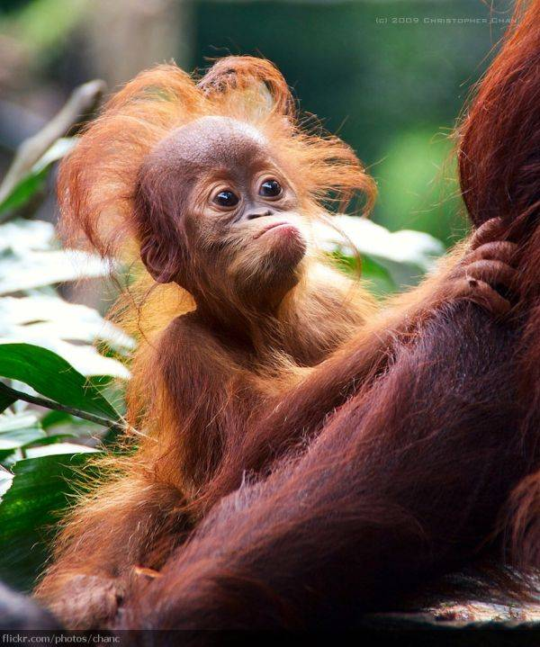
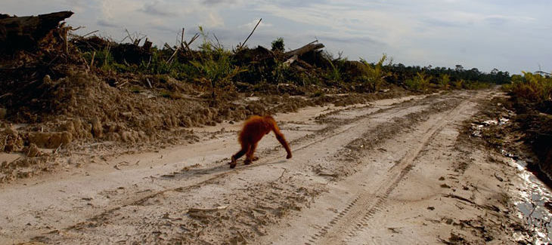
Topic 3.4: Conservation of biodiversity
Significant ideas:
The impact of losing biodiversity drives conservation efforts.
The variety of arguments given for the conservation of biodiversity will depend on EVSs.
There are various approaches to the conservation of biodiversity, each with associated strengths and limitations.
Starter:
Why conserve biodiversity?
Whose responsibility is it?

Slide 2
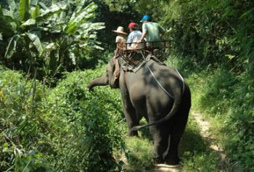
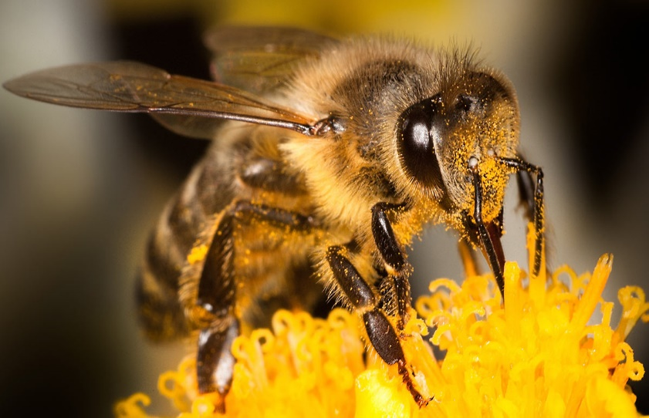
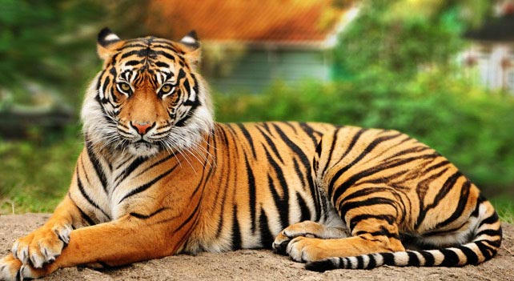
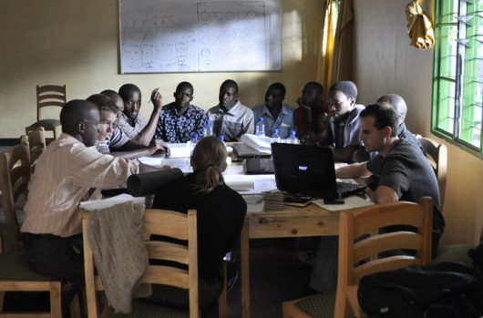
Why conserve biodiversity?
Economic
Ecological
Social
Aesthetic

Slide 3
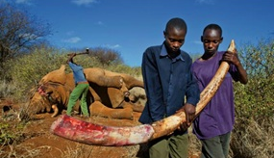
Why NOT conserve biodiversity?
Discuss with your group:
Under each column can you think of reasons to not conserve biodiversity.
It is important to understand that these arguments are not black and white.
A poacher can make almost 500 000 THB from the tusks of an adult male elephant; the average annual salary in Kenya is around 30 000.
It is very easy for us in a more developed country to judge people in developing countries who are doing things we consider evil.

Slide 4
Ethical arguments
Usually very broad.
Rely on people believing these species have an intrinsic value or taking a utilitarian approach.
Intrinsic value – the value a species has within its own right (as opposed to the value it can give).
Utilitarianism – taking the best moral action that maximises happiness/minimises suffering to sentient entities.
How to do we change people opinions?

Slide 5
Conservation organisations
IGOs, GOs, NGOs
Intergovernmental organisations
E.g the UN, IPCC
Governmental organisations
E.g Environment agency
Non-governmental organisations
E.g. Friends of the Earth

Slide 6
Using the logos:
Which organisation is it from?
Is it an IGO, GO or NGO?
What are its main aims?
How does it accomplish these aims?
Place the organisations onto the axis to the right.
Desk-based research
Radical
Conservative
In the field

Slide 7
Use of media
IGO and GO | NGO
Statements written by officers and clerks. Works alongside official media outlets. | Graphic/shocking footage to gain media attention. Mobilise public protests to attract attention. Effective use of social media to spread message. Sabotage events with high media coverage
Both publish scientific reports
https://www.youtube.com/watch?v=soxlqX5U2iQ
https://www.youtube.com/watch?v=x59BDg3CnhQ
https://www.youtube.com/watch?v=qMfako9JNpE

Slide 8
Speed of response
IGO and GO | NGO
Considered and slow (bureaucratic). May go against public opinion so many views need to be considered. | Can be rapid. Member only join if they share opinions, so little deliberation. Little consideration of the status quo.
https://www.youtube.com/watch?v=wD3AoDAV-rA

Slide 9
Diplomatic constraints
IGO and GO | NGO
Considerable - often hindered by political disagreement (different cultural opinions and motives) Decisions can be politically driven rather than by best conservation strategy. E.g. voting in the IWC | Generally unaffected by political constraints Can even include illegal activity. Driven by what is best for conservation – can lead to extreme actions

Slide 10
Financial resources
IGO and GO | NGO
Potentially very large budgets. (Highly variable) Funded by national budgets (taxes) | Manage publicly owned lands. Private donations. Can be funded by companies, governments or political parties (however some explicitly refuse this).

Slide 11
Political influence
IGO and GO | NGO
Some countries have more power than others. Biodiversity is not equally spread among all countries. Countries can be fined/shunned for breaking international rules. | Varies greatly depending on reputation. Often relies on disruptive/embarrassment techniques to cause change.

Slide 12
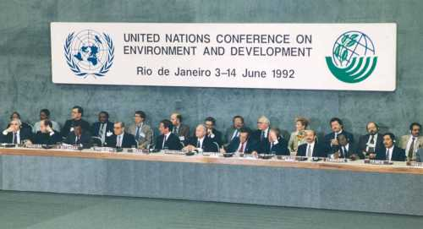
Conservation Milestones
There are going to be a list of dates and what happened.
DO NOT write them all down.
You do not need to know the dates or exact events.
You do need an idea of how the world comes together to elicit change and how effective these interventions have been.

Slide 13
Conservation Milestones
1980 – World Conservation Strategy
Maintain essential ecological processes and life support systems;
Preserve genetic diversity;
Ensure sustainable utilisation of species and ecosystems.
1991 – Caring for the Earth: A Strategy for Sustainable Living
Stated benefits of sustainable use of natural resources and sharing resources more equally.
1992 – Rio Earth Summit – Agenda 21 (sustainable development agenda)
Conservation of biological variation
Sustainable use of its components
Equitable sharing of the benefits arising out of the utilisation of genetic resources.

Slide 14
Conservation Milestones
2000 – UN Millennium Summit: Millennium Development Goals. World leaders agreed on set of time bound and measurable goals. Many issues including poverty/hunger/gender equality.
2005 – World Summit, New York. Outlined global priorities and recommended each country prepare a national strategy for the conservation of natural resources.
2010 – In 2001 EU heads of state agreed to halt biodiversity decline by 2010. They failed.
2013 – Rio+20. How to build a green economy. Resulted in non-binding paper “The future we want”.

Slide 15
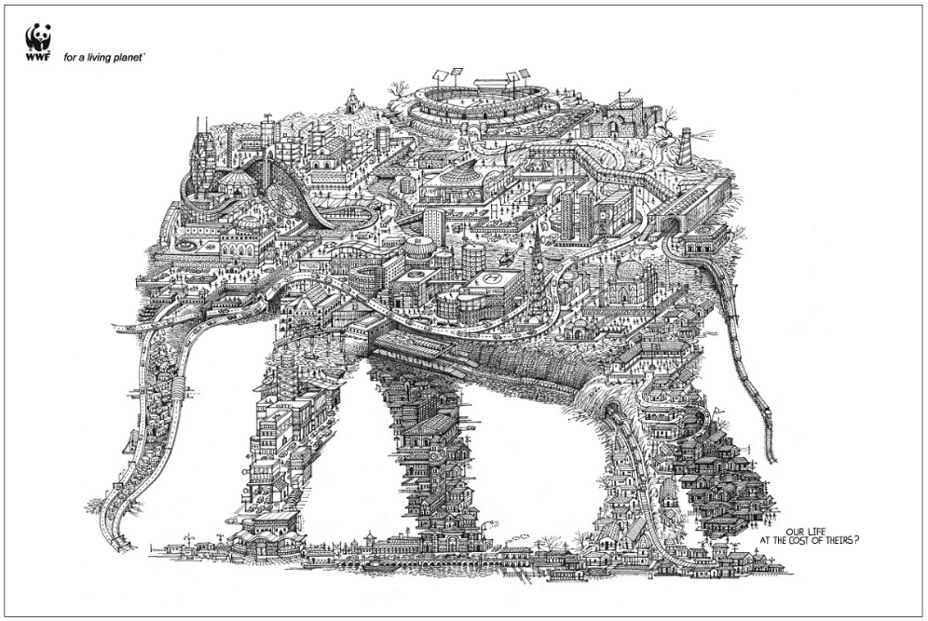
Approaches to conservation:
Three main approaches :
Species based
Habitat based
A mixture of both
More successful when it involves:
Research
Adequate funding
Support of the local community

Slide 16
CITES
Species-based conservation
https://www.youtube.com/watch?v=BodUHLH_UcY
The Convention on International Trade in Endangered Species of Wild Fauna and Flora.
An agreement between governments to address the problem of wildlife trade.
Governments must sign up voluntarily and create their own national laws.
Has generally been very effective, however little incentive for governments to comply.

Slide 17
CITES
Species-based conservation
Animals are classified according to how threatened they are by international trade.
Appendix I – cannot be traded internationally as they are threatened with extinction.
Appendix II – international trade but within strict regulations ensuring its sustainability.
Appendix III – included at the request of a country which needs the cooperation of other countries to help prevent illegal exploitation.

Slide 18
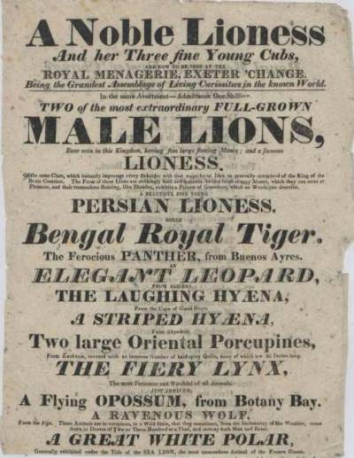
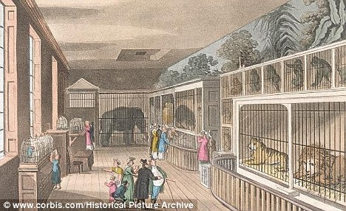
Captive breeding and zoos
Species-based conservation
The leaders of countries often showed their power by keeping a variety of exotic beasts, known as Royal menageries.
Heads of state would gift each other animals.
First zoos were when these were opened to the public.

Slide 19
Captive breeding and zoos
Species-based conservation
Since then zoos and aquaria have had to justify their existence.
This usually takes the form of captive breeding and funding conservation alongside education.
Using the internet:
Research a successful reintroduction programme. E.g. Black-footed ferret.
What species was involved?
Why was it successful?
What were the opinions of the local communities?
Why are reintroductions from captive bread populations so difficult?
Explain the concept of a frozen zoo.

Slide 20
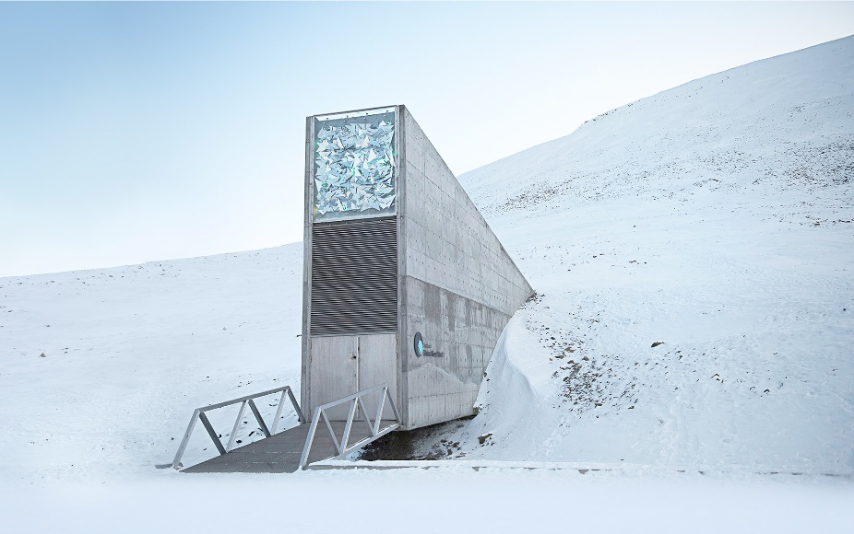
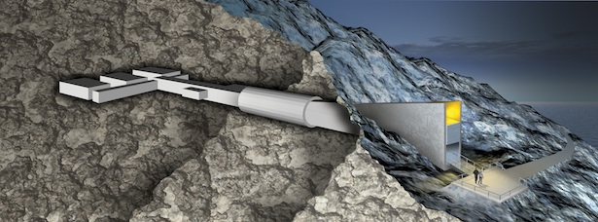
Botanical gardens and seed banks
Species-based conservation
https://www.youtube.com/watch?v=r4U3EEkkVoM
Kew Gardens (in London) is the largest botanical garden in the world; it contains 25000 plant species (10% of the world’s total)
Seed banks are where seeds are stored, frozen and dry, for many years.
Global Seed Vault in Svalbard – secured seed bank, to act as a insurance against loss of other seed banks. No power needed.

Slide 21
Flagship species
Species-based conservation
Charismatic, recognisable and popular.
Not necessarily ecologically important.
But attract funding for areas that need conservation efforts.
Umbrella species
Disadvantages of naming flagship species:
Takes priority over others (even if it is not the most in need).
If they become extinct the message is we have failed.
They may be in conflict with the local peoples, e.g. man-eating tigers

Slide 22
Keystone species
Species-based conservation
Critical role in maintaining the structure of the ecosystem it lives in.
Disappearance of this species could cause the disappearance of many others.
If conservation is to be successful these species must be identified.
Often engineers (e.g. beavers) that create habitats or small predators (e.g. sea otters) that keep herbivore numbers low enough that producers can survive.

Slide 23
Designing protected areas
Habitat-based conservation
How large should it be?
One large or many smaller?
How many individuals need to be protected?
What is the best shape?
How close should reserves be to one another?
Should they be joined by corridors?
In pairs:
Using the statements try to pair up the cards

Slide 25
On MWB- Which is better and why?

Slide 26
On MWB- Which is better and why?

Slide 27
On MWB- Which is better and why?

Slide 28
On MWB- Which is better and why?

Slide 29
On MWB- Which is better and why?

Slide 30
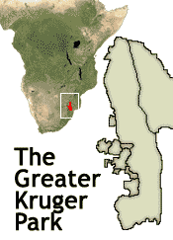
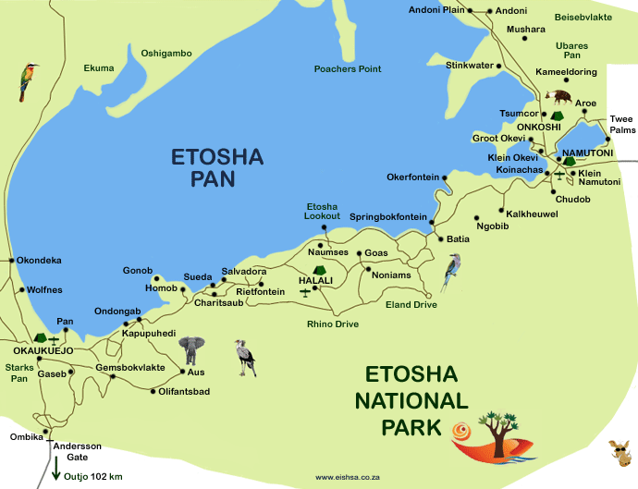
Case Study
Research a protected area.
You need to be able to evaluate the success of it.
What went well, what failed?

