Slide 1
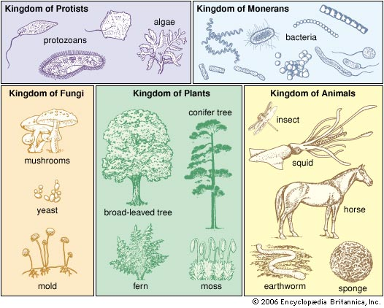
2. 5 Investigating Ecosystems : Classification & Dichotomous Keys

Slide 2
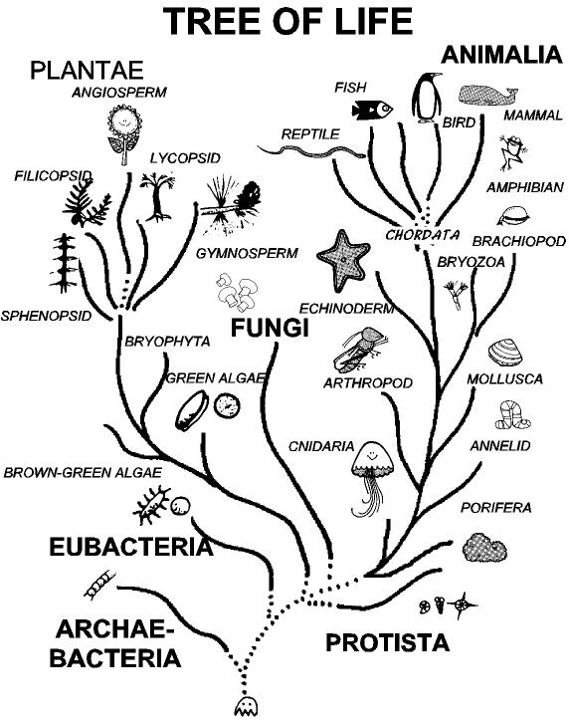
What is classification?
Classification is the grouping of living organisms according to similar structures and functions.
Teacherweb.com

Slide 3
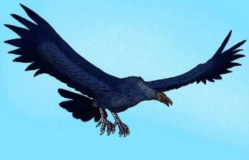
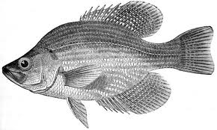
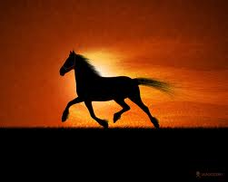
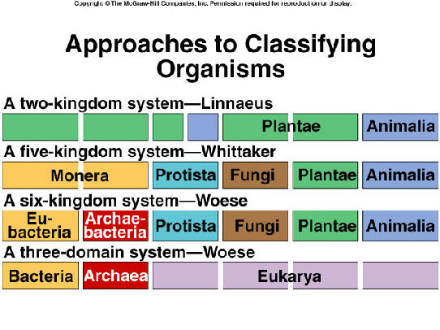
Early classification systems
Aristotle grouped animals according to the way they moved
http://faculty.southwest.tn.edu/rburkett/classification_of_organisms.htm

Slide 4
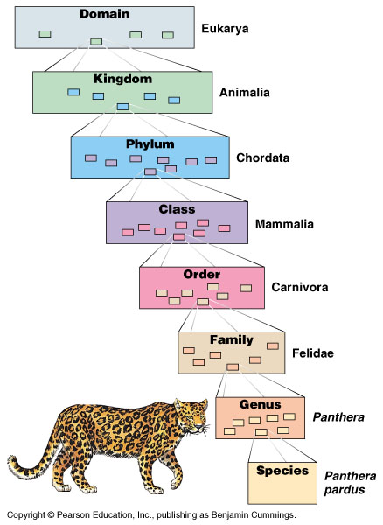
Modern classification:
Developed by Carolus Linnaeus
Kingdom
Phylum
Class
Order
Family
Genus
Species

Slide 6
Levels of Classification
  The seven levels are (with an example for housecats)
    Kingdom (Animalia – the animals)
    Phylum (Chordata – animals with backbones)
    Class (Mammalia – mammals)
    Order (Carnivora – carnivores, animals that eat meat)
    Family (Felidae – the cat family)
    Genus (Felis – housecats, cougars, and many others)
    Species (catus – housecats)
  While many organisms can share the more broad levels, less and less animals share the levels as it goes down and only one species will have each Genus and species combination

Slide 7
Helpful way to remember the 7 levels
King Philip Came Over For Grape Soda.
King Philip Came Over For Green Skittles.
Kristin Page Can Ollie Five Giant Stairs
Mnemonics are useful ways to memorize lists. Try making your own!

Slide 8
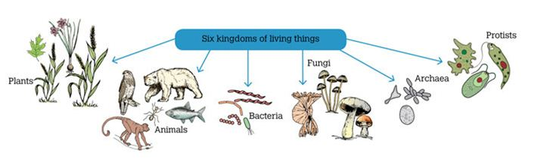
Six Kingdoms of Living Things
  Plantae – plants, autotrophs
  Animalia – animals, heterotrophs
  Fungi – mushrooms, molds, and yeasts, all are decomposers
  Protista – very complex unicellular organisms or simple multicellular organisms
  Archaea – similar to bacteria, but has different structures
  Bacteria – simple unicellular organisms

Slide 9
Using the Classification System
There are many methods to help identify an organism you are studying. These include:
Field guides help identify organisms.
Comparing organisms with pictures
Using photography
Referencing collections (previously collected samples)
Comparing characteristics (behaviors, sounds, distribution, time of year)
Comparing DNA (genetic analysis)
Using Dichotomous Keys

Slide 10
Dichotomous Key
A pair of statements that describe the physical characteristics of different organisms
1a Fruits occur singly ....................................................... Go to 3
1b Fruits occur in clusters of two or more ......................... Go to 2
2a Fruits are round ....................................................... Grapes
2b Fruits are elongate ................................................... Bananas
3a Thick skin that separates easily from flesh .............Oranges
3b Thin skin that adheres to flesh .............................. Go to 4
4a More than one seed per fruit ............................ Apples
4b One seed per fruit ............................................ Go to 5
5a Skin covered with velvety hairs .................... Peaches
5b Skin smooth, without hairs ........................... Plums
What steps would you use to identify a peach?

Slide 11
Example of a Dichotomous Key
1. Organism is a plant ........................................ Go to 2
Organism is not a plant (animal) .....................Go to 5
2. Has no 'true' leaves or roots ........................... Bryophyta
Has leaves and roots ......................................Go to 3
3. Has no seeds (sporangia) .............................. Filicinophyta
Has seeds .......................................................Go to 4
4. Has no flowers ............................................... Coniferophyta
Has flowers .................................................... Angiospermophyta
5. Asymmetrical body plan ................................. Porifera
Symmetrical body plan ...................................Go to 6
6. Has radial symmetry .......................................Cnidaria
Has bilateral symmetry ...................................Go to 7
7. Has no anus ................................................... Platyhelminthes
Has an anus ....................................................Go to 8
8. Has a segmented body ...................................Go to 9
Has no visible body segmentation ...................Mollusca
9. Have an exoskeleton ...................................... Arthropoda
Have no exoskeleton ...................................... Annelida
From www.bioninja.com

Slide 12
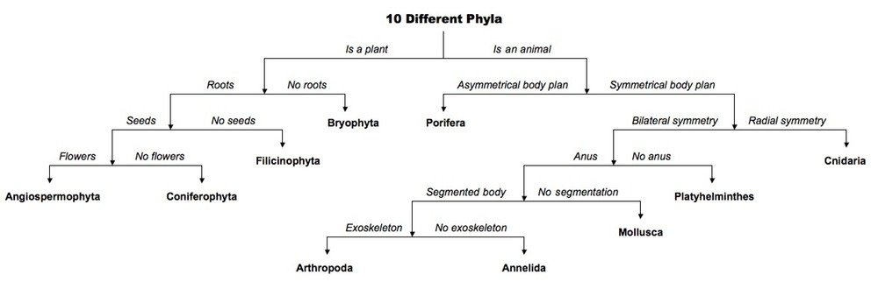
Same Key – Different Look
Branching Key
Note: Still always 2 options
From www.bioninja.com

Slide 13
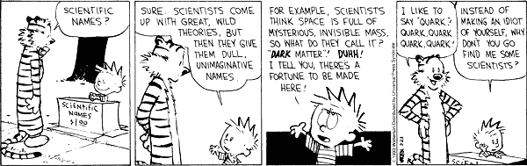
Purpose of Dichotomous Key
To identify the specific organisms you find in the field
Allows you to distinguish between closely related organisms
Will lead you to the specific species of the organism which is shown by giving you the scientific name.

Slide 14
Binomial Nomenclature
Developed by Carolus Linnaeus
Two-name system:
  First name is the organism’s Genus
  Second name is the organism’s species

Slide 15
What rules are used to write scientific names?
The first letter of the Genus is ALWAYS capitalized
The first letter of the species is NEVER capitalized
Scientific names of organisms are always italicized or underlined
Genus species or Genus species

Slide 16
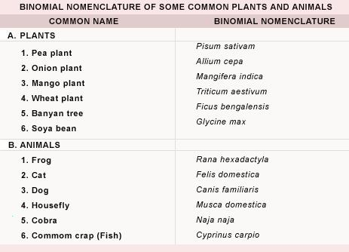
biology.tutorvista.com

