Slide 1
5.2 Terrestrial Food Production Systems and Food Choices

Slide 2
Discuss
Even though our world produces enough food for everyone, about one in eight of us still goes to bed hungry each night.
What are some of the reasons that people go hungry?
Can you name some places in the world where people are experiencing hunger right now?
What are some specific things, we as individuals can do to help end hunger for others, locally and globally?

Slide 3
What is the Problem?
870 million people (1 in 8) suffer from chronic undernourishment (deficiency of calories and protein) worldwide
Poor nutrition plays a role in at least half of the 10.9 million child deaths each year
The world produces enough food to feed every person on Earth (actually, in excess) however, it is lack of transportation, access to land, water, and money to distribute this food that creates the shortages
Poverty, harmful economic systems, conflict, and climate change all contribute to the problem

Slide 4
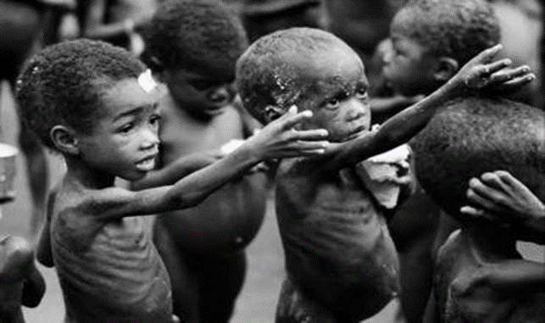
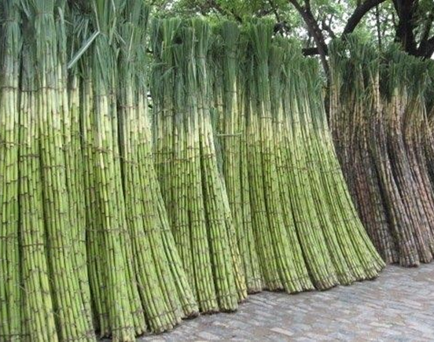
Inequalities exist in food production
and distribution around the world
¾ of the world is inadequately fed with about 1 billion going hungry
Too much food is being produced in MEDCs leading to surplus and lowered price of food.
Some MEDCs have import tariffs which make the import of food more expensive.
LEDC food production is often used as a way to generate foreign income from cash crops leading to an emphasis on export, rather than feeding the local population.

Slide 5
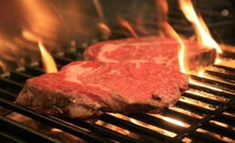
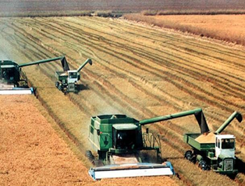
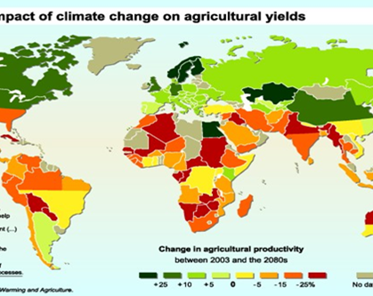
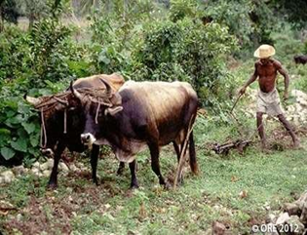
Inequalities exist in food production and distribution around the world
Long-standing imbalance between rich and poor countries in international agricultural trade.
Domestic support and export subsidies to farmers in MEDCs make LEDC crops uncompetitive.
Increased meat/dairy consumption and biofuel use, pushes prices up as land isn’t used for food crops.
Climate change with higher temps in tropical and subtropical areas can lead to crop loss.
MEDC farms are very technocentric, whereas LEDC farms are very labor intensive (usually from within the family.)

Slide 6
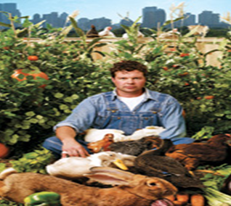
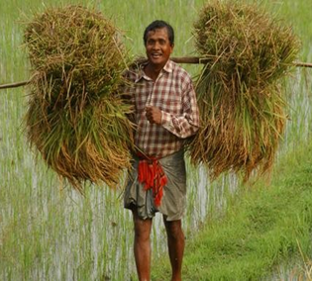
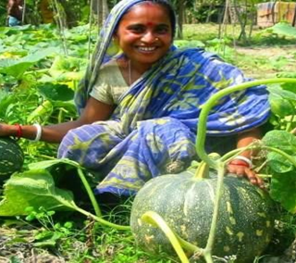
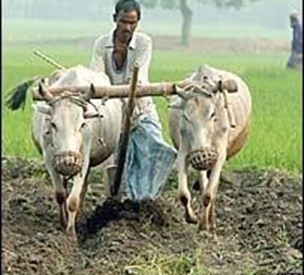
FARMING SYSTEMS
Subsistence Farming
Producing food for family and local community
No surplus
Human and animal labour (low tech)
Mixed crops
Low inputs of energy from fossil fuels or chemicals
Cash cropping = growing crop for market

Slide 7
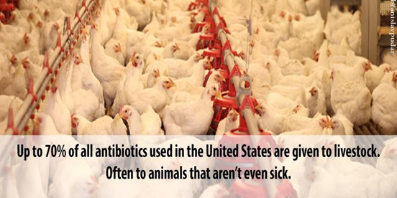
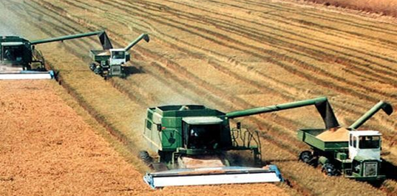
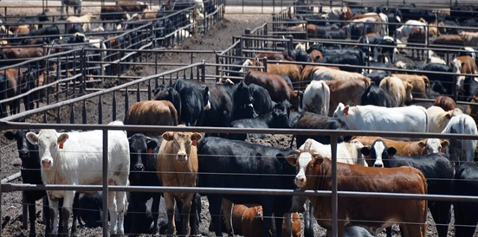
FARMING SYSTEMS
Commercial Farming
Production for PROFIT
Maximizing yield
High level of technology
Monocultures (crop or animal)
High inputs of energy from fossil fuels & chemicals
Extensive = more land with lower stocking/planting
Intensive = use land more intensively with high input and output per unit area

Slide 8
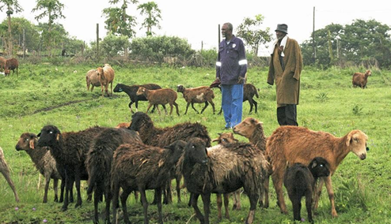
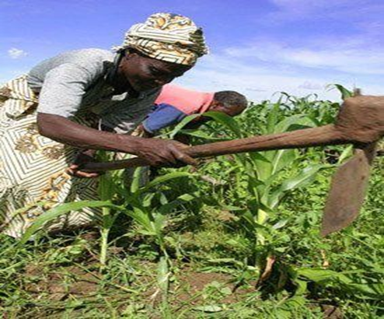
FARMING SYSTEMS
Pastoral Farming
Raising animals on grass and land not suitable for crops
Arable Farming
Growing crops on good soil to eat directly or feed to animals
Mixed Farming
Crops and animals
Animal waste used to fertilize crops
Crops used to feed animal

Slide 9
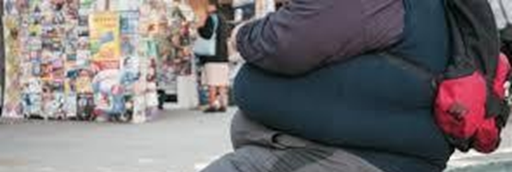
FACTS ABOUT FOOD
Malnutrition = “bad” nutrition due to unbalanced diet
Undernourished = lacking calories (not enough food) ~870 million people in world
Overnourished = too many calories leads to obesity
Unbalanced = not the right amount of nutrients for optimal health

Slide 10
MEDC’s vs. LEDC’s
MEDC Countries
Cost of food relatively cheap
Surplus of food stores
Food choice based on preference not nutritional need
Technology and transportation systems allow imports and food produced year round
LEDC Countries
Struggle to produce enough food for population
Political, economic and environmental limits on food production
Food choice determined by availability
Seasonal
Cash cropping – crops for export to make profit instead of for locals (coffee, hemp, flax, biofuels)

Slide 11
MEDC’s vs. LEDC’s
MEDC Countries
Average energy intake 3314 calories per day
12.9% calories from meat
1.4% calories from fish
37.3% calories from cereals
LEDC Countries
Average energy intake 2666 calories per day
7.3 % calories from meat
0.9% calories from fish
56.1% calories from cereals

Slide 12
WHAT DETERMINES OUR FOOD CHOICES?
What foods we grow and eat are determined by:
Climate – determines availability (although we
adapt this through irrigation & greenhouses)
Cultural & Religious influences – traditions influence preferences, Hindu – no beef, Islam – no pork, Buddhism - vegetarian
Politics – subsidies and tariffs on some food
Socio-economics – supply/demand, affordability

Slide 13
Comparison of 2 Food Production Systems
Thailand Rice Production
Traditional Extensive
Low inputs of energy and chemicals
Labor intensive
Low productivity
High energy efficiency
No fertilizers/pesticides
California Rice Production
Intensive Farming
High inputs of energy and chemicals
Energy inputs = petrol
High productivity
Large amounts of fertilizers and pesticides
High rice yield
Lower energy efficiency
GMO’s possible

Slide 14
Terrestrial vs Aquatic Food Production Systems
Terrestrial
Harvested from lower trophic levels (producers or primary consumers). Efficient use of solar energy.
Crops more efficient than livestock as they contain the most energy. (livestock has skeletal waste)
Livestock provide protein source.
Livestock often have additional products (milk, blood, wool, hides)
Livestock may be used as working animals in many cultures.

Slide 15
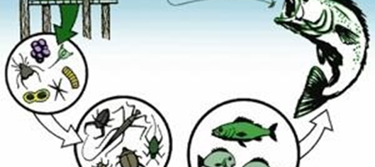
Terrestrial Vs Aquatic Food Production Systems
Aquatic
Most food harvested from higher trophic levels (3rd or even 4th level consumer)
Much less efficient than crops, energy has been used and lost as heat (10% rule)
Energy conversions along aquatic food chains may be more efficient than terrestrial, however initial fixing of energy by aquatic producers is less efficient due to absorption & reflection of light by water.

Slide 16
Increasing Sustainability of Food Supplies
WHAT IS THE PROBLEM?
Population is growing, available agricultural land is decreasing due to soil erosion, salinization, urbanization, and desertification.

Slide 17
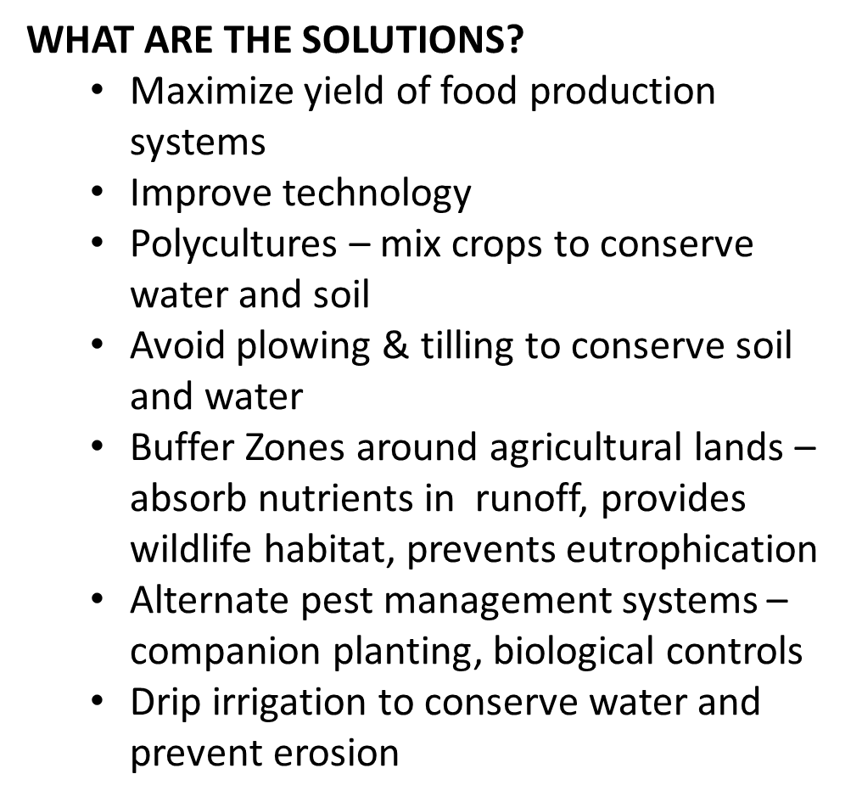
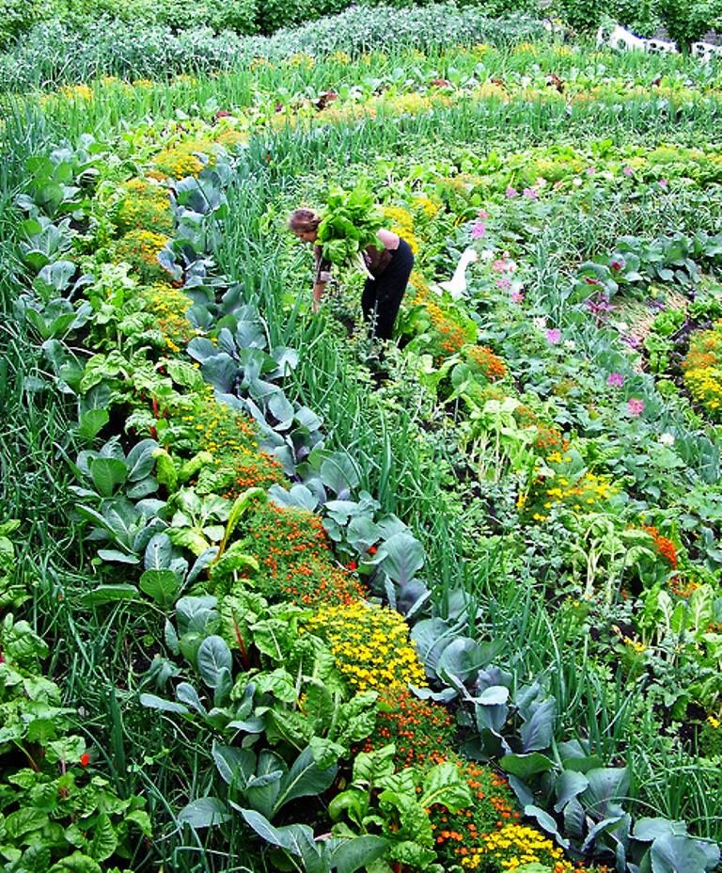
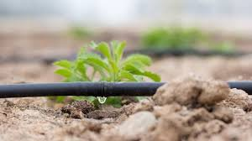
Increasing Sustainability of Food Supplies

Slide 18
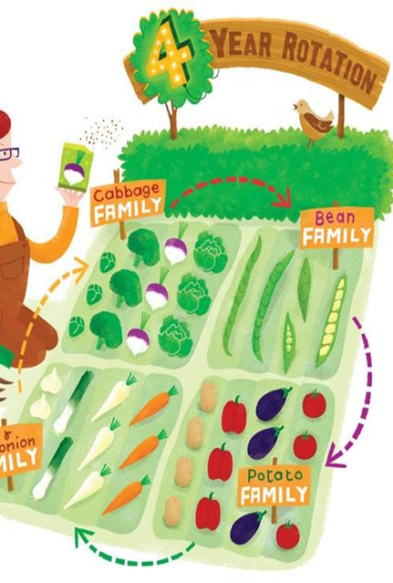
Increasing Sustainability of Food Supplies
WHAT ARE THE SOLUTIONS?
Maximize yield of food production systems
Alter what is grown:
Genetically modified foods (GMO) – Very controversial
Aquaculture & hydroponics
Crop rotation

Slide 19
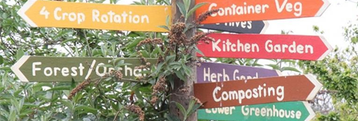
Increasing Sustainability of Food Supplies
WHAT ARE THE SOLUTIONS?
Maximize yield of food production systems
Green Revolution:
Agroecology – closed system farms
Drought resistant crops
Quick growing ground cover between crops

Slide 20
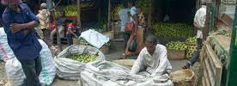
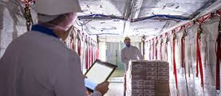
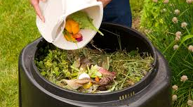
Increasing Sustainability of Food Supplies
WHAT ARE THE SOLUTIONS?
Reducing Food Waste
Improve storage in LEDCs – avoid loss to infestations, weather, lack of refrigeration or preservation methods
In MEDCs food waste is due to overconsumption
Only purchase what is needed
Composting and using in garden
Use food waste for livestock

Slide 21
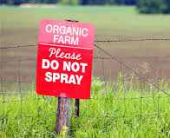
Increasing Sustainability of Food Supplies
WHAT ARE THE SOLUTIONS?
Monitoring & Controlling
Governments (GOs) and Intergovernmental bodies (IGOs) regulate imports and exports
GO and IGOs regulate unsustainable agricultural practices
Multinational and National food corporations raise standards for supply farms
Individuals and NGOs apply pressure to farmers

Slide 22
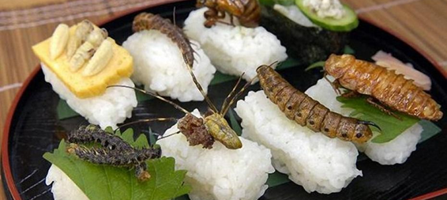
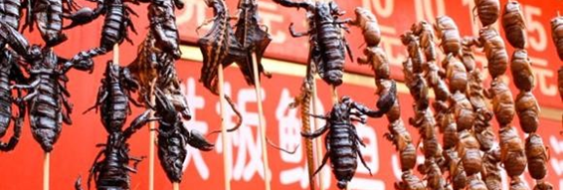
Increasing Sustainability of Food Supplies
WHAT ARE THE SOLUTIONS?
Changing attitudes about food and diets
Eat different crops that are more sustainable
Eat less meat
Increase education about food and diet
Increase insect consumption (large protein source, r-strategists)

Slide 23
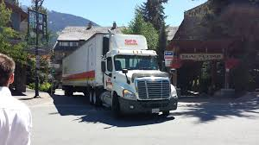
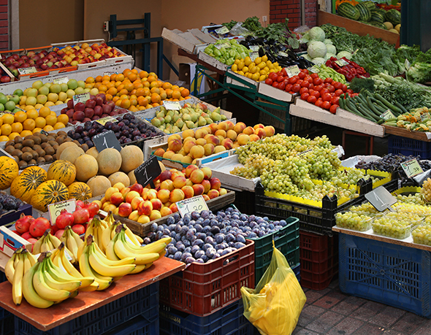
Increasing Sustainability of Food Supplies
WHAT ARE THE SOLUTIONS?
Change How we Sell Food
Reduce processing – whole foods are more nutritious
Reduce packaging – creates domestic waste
Reduce transporting foods – increases use of fossil fuels (must balance energy use and efficiency, it may be more efficient to import a product than to grow in a climate where it requires a lot of energy)

