Slide 1
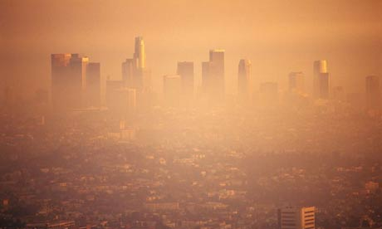
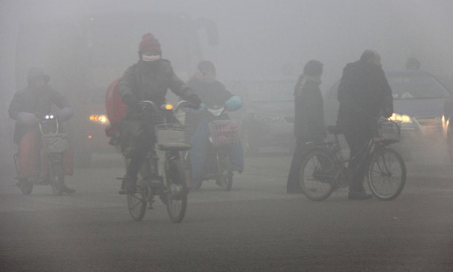
Topic 6.3 Photochemical Smog
Starter:
What is smog?
What do you think photochemical means?

Slide 2
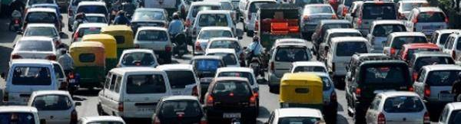
The problem…
1 billion people are exposed to outdoor air pollution per year.
1 million premature deaths due to air pollution.
Causes losses in a countries production.
90% of air pollution in LEDCs comes from old motor vehicles which are poorly maintained.

Slide 3
Primary pollutants
Emitted directly from the polluting process.
The process could be natural or anthropogenic.
Fossil fuel combustion primary pollutants:
Carbon monoxide
Carbon dioxide
Unburned hydrocarbons
Nitrogen oxides
Sulfur oxides
Particulate matter (PM) – e.g. black carbon or soot (causes lung diseases and cancer)
Create a list of natural and anthropogenic sources of primary pollutants.

Slide 4
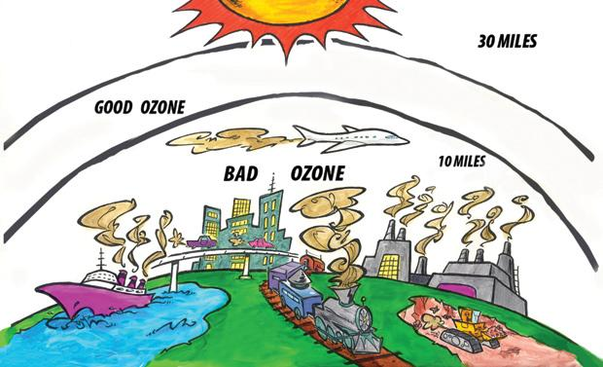
Secondary pollutants
Formed when primary pollutants undergo reactions with other chemicals already present in the atmosphere; sometimes this is a photochemical reaction in the presence of sunlight.
Examples:
Tropospheric ozone
Particulates produced from gaseous primary pollutants
Peroxyacetyl nitrate (PAN)

Slide 5
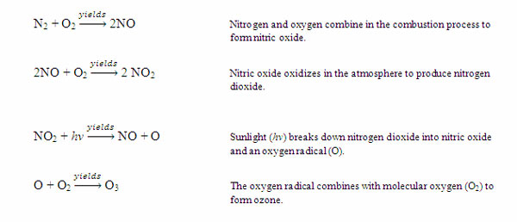
Formation of tropospheric ozone
Nitrogen oxides form as a by product of combustion reactions.
Oxygen and nitrogen (both from the air) react together as a results of the high temperatures.

Slide 6
Formation of tropospheric ozone
In normal conditions most ozone molecules oxidise nitric oxide back into nitrogen dioxide, creating a cycle.
This leads only a small build up of ozone near ground level.
Video - Ozone production

Slide 7
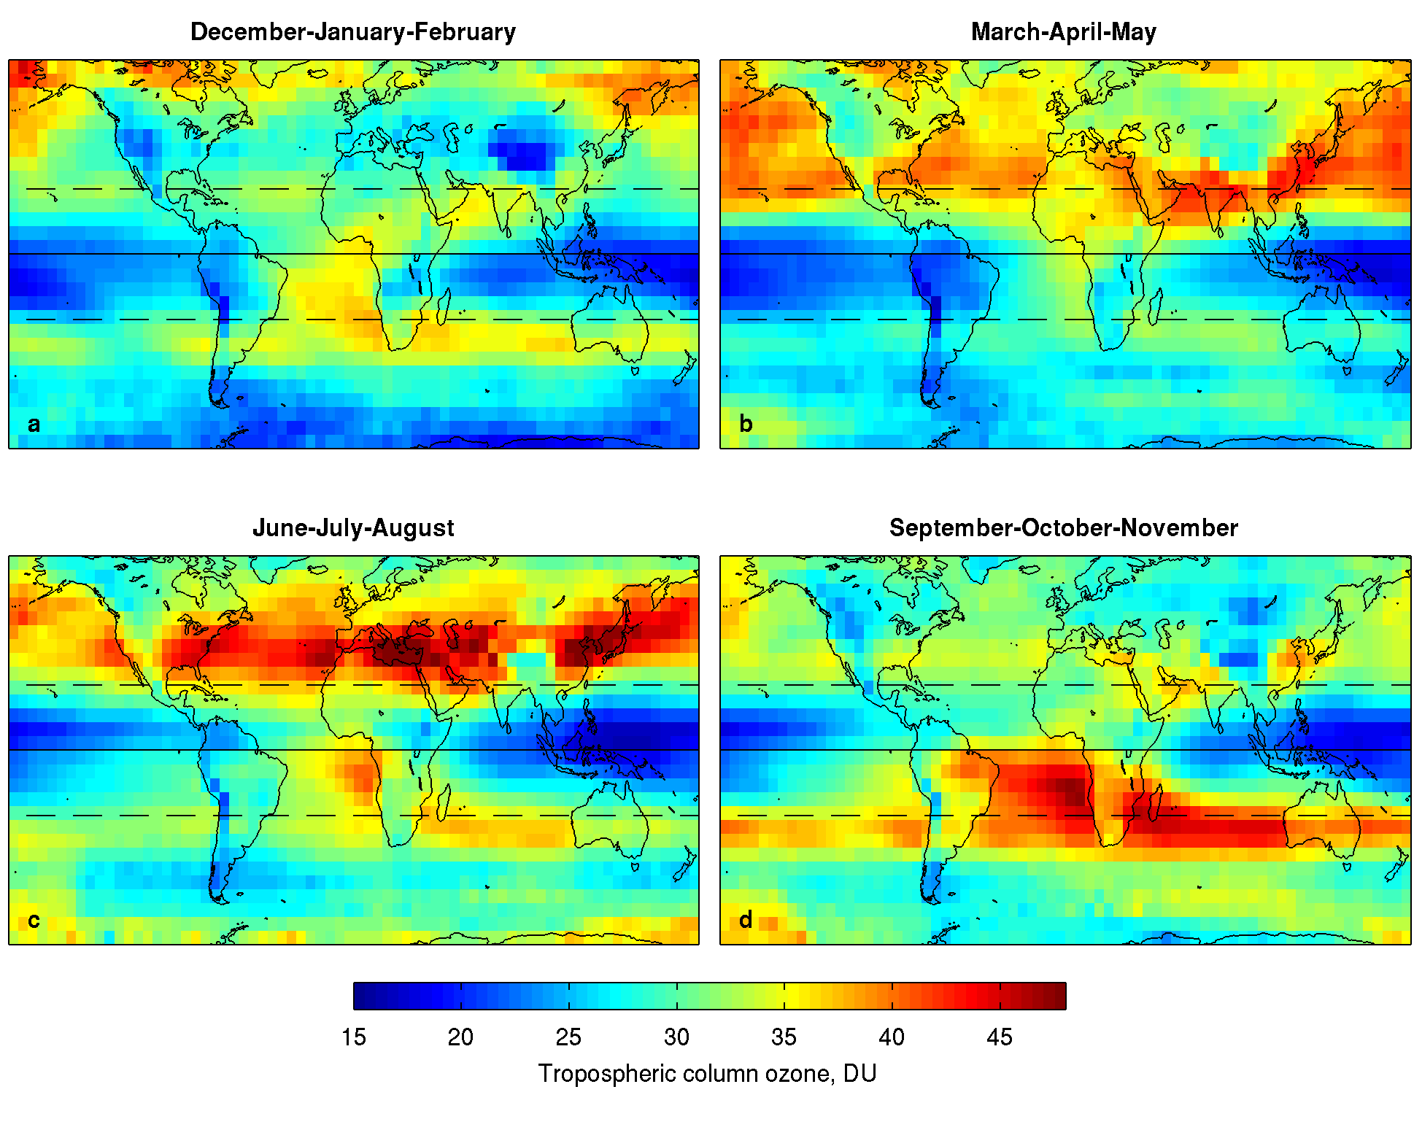

Slide 8
Formation of tropospheric ozone
Highest in places that are sunny, and have high traffic density.
E.g. LA, Mexico City, Shanghai, Bangkok.
Worse in areas where topography limits air circulation.
http://aqicn.org/map/world/#@g/66.3942/-242.6039/2z
http://www.londonair.org.uk/london/asp/annualmaps.asp?species=O3&LayerStrength=75&lat=51.5008010864&lon=-0.124632000923&zoom=14

Slide 9
Why are the richest areas of cities usually to the west and on hills?
In Western Europe (and most of the northern hemisphere) the prevailing wind direction is from West to East.
This meant that during the industrial revolution most air pollutants were blown away from western parts of the city and towards the eastern parts.
The rich could afford to move to areas free of pollution leaving the poor in areas the worst effected.

Slide 10
Possible effects of ozone
Ozone is a toxic gas and an oxidising agent
Plants:
Ozone absorbed into plants through leaves.
Degrades chlorophyll.
Reduces photosynthesis therefore productivity.
Humans:
Reduces actions in lungs causing breathing difficulties.
Increase susceptibility to infection (respiratory disease)
Eye, nose and throat irritation.
Materials and products:
Attacks rubber, cellulose and some plastics.
Reduces life of car tires
Bleaches fabrics.

Slide 11
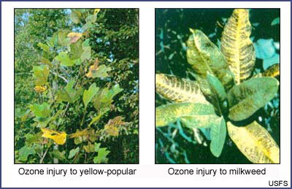

Slide 12
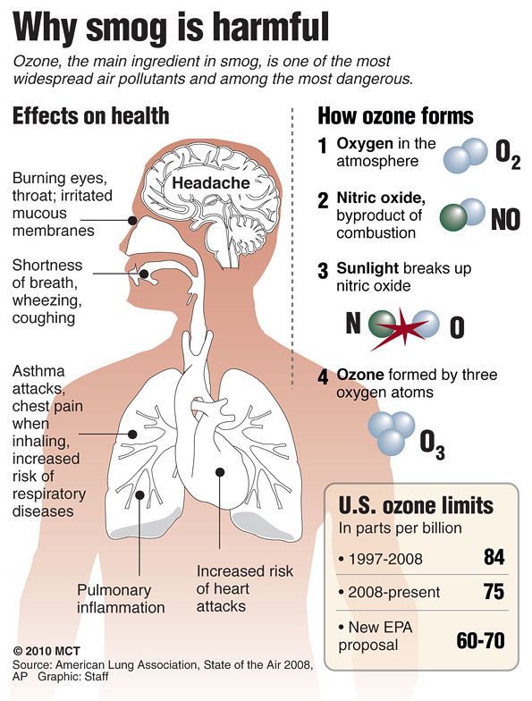

Slide 13
Discuss the formation of tropospheric ozone and its effects on living organisms. (6)

Slide 14
Formation of particulates
Dangers:
Too small for our respiratory filters (nose and cilia) to catch.
Enter our body and stay there causing asthma, lung cancer and respiratory problems.
In areas close to industrial or dense urban areas the particulates cover the crops and block sunlight reaching the leaves.
Burning almost any organic material or fossil fuel released small particles of carbon and other substances.
Poorly maintained diesel engines are particularly polluting.
Often referred to as particulate matter, PM10 or PM.

Slide 15
Formation of photochemical smog
Haze caused by high levels of atmospheric pollutants, primarily ozone and nitrogen oxides, interacting with strong sunlight.
On warm, sunny days, with lots of traffic photochemical smog can be formed over cities.
Fossil fuel combustion.
Forest burning.
Frequency and severity of smog depends on local topography, climate, population density and fossil fuel use.

Slide 16
Thermal inversion
Normal warm air from a city will rise, allowing pollutants to escape.
On warm days a hot layer can trap the cooler air from the city, trapping the pollutants.
Rain can clear air pollutants.
Wind will disperse it.

Slide 17
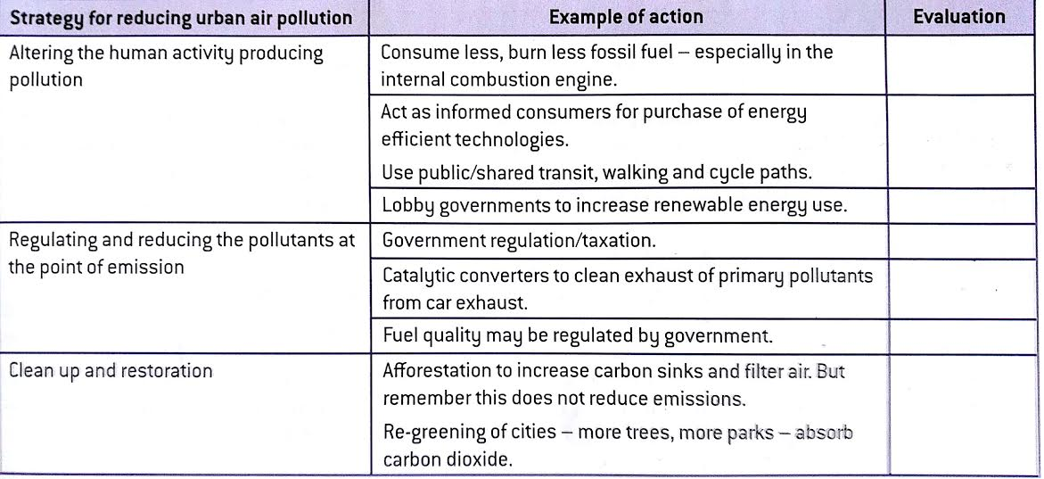
Replace, regulate, restore
Using the internet and your own ideas evaluate each of the action in the above table.

