Slide 1
Populations

Slide 2
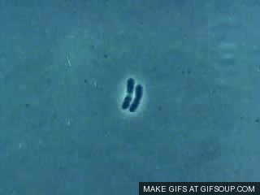
How does a population grow?
Exponential Phase:
Birth > death
No factors limiting growth.
More individuals available for reproduction.
True exponential growth is only usually seen in cell populations.
Cannot last forever.
Lag Phase:
Little or no population growth
Period of adaptation or preparation for growth.
Stationary Phase:
Birth = death
CARRYING CAPACITY - This is the maximum size population a particular environment can support.
Death Phase:
Birth < death
Occurs when all resources have been used up.

Slide 3
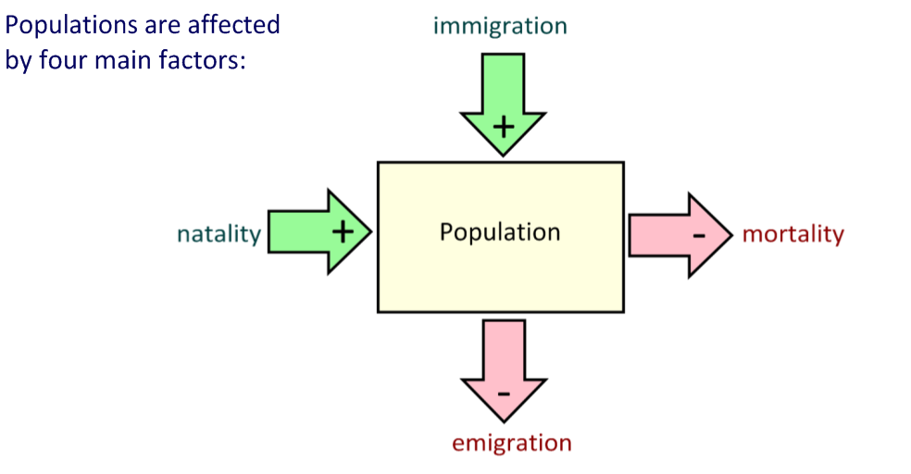
What factors affect populations?

Slide 4
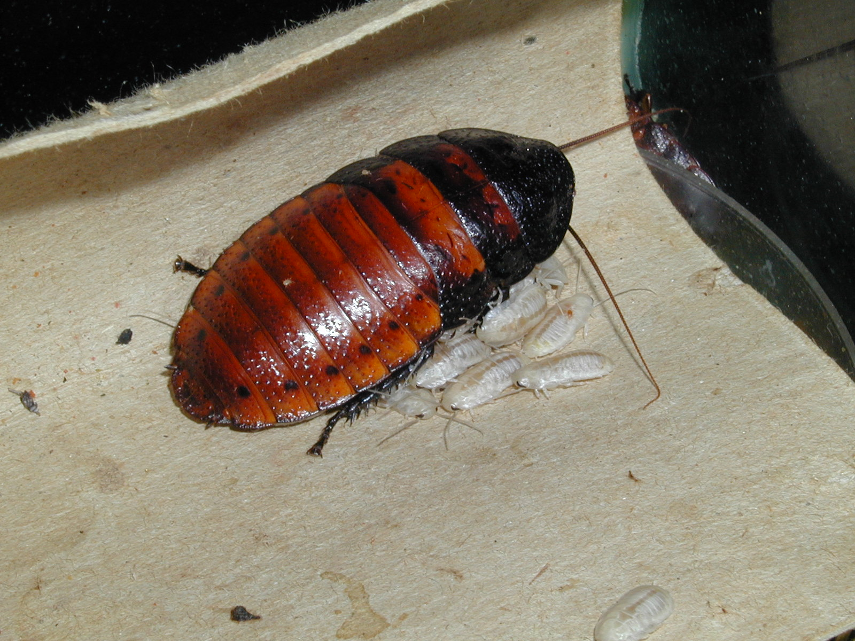
Four Factors Influence the Size of a Population:
Babies!
Natality: Birth Rate (offspring produced and added to population)

Slide 5
Mortality: Death Rate (individuals that die)

Slide 6
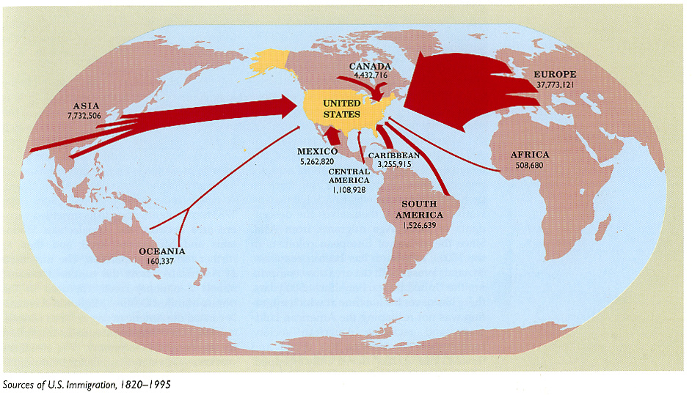
Immigration: Movement of members of the species into the area

Slide 7
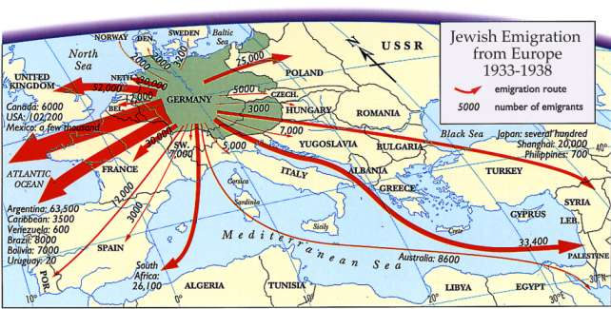
Emigration: Movement of members of the species out of area to live elsewhere.

Slide 8
Population Change
Population Change =
(natality + immigration) – (mortality + emigration)

Slide 9
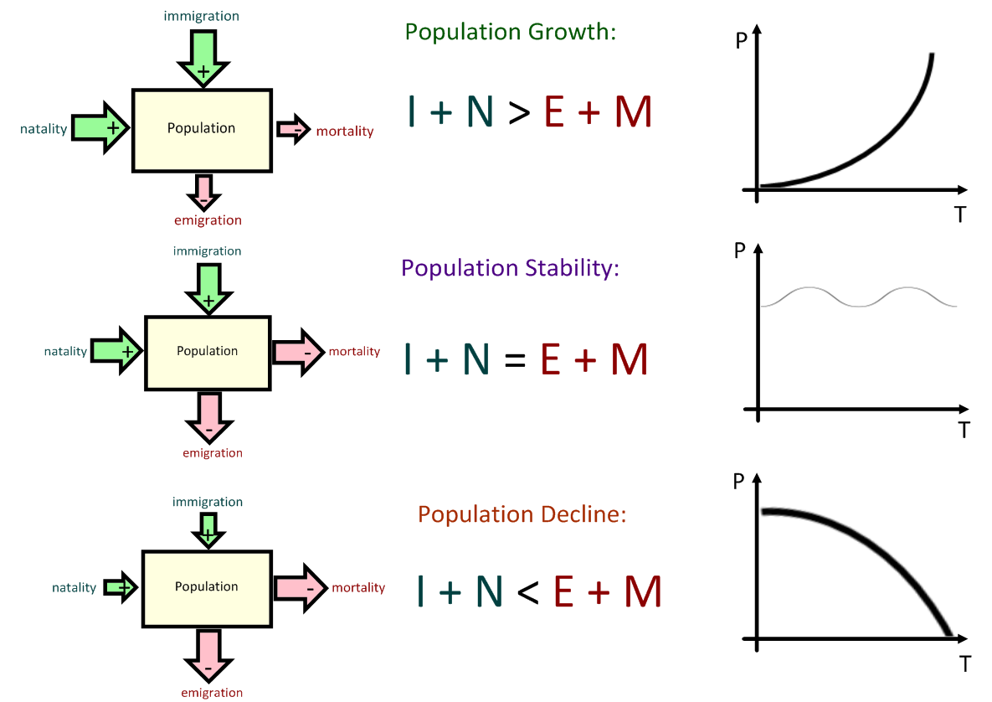

Slide 10
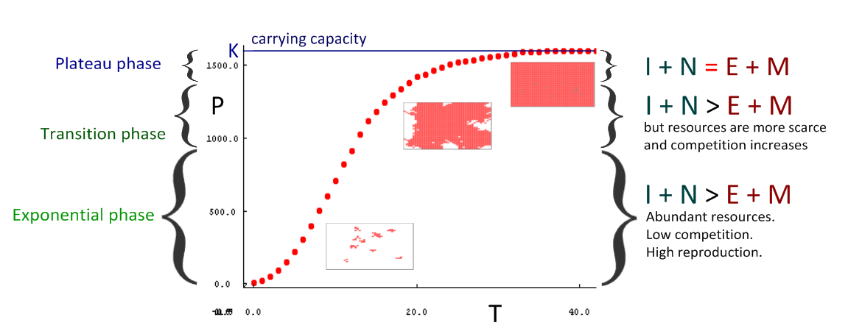

Slide 11
Limiting factors
Limiting factors can be defined as the factors that limit the distribution or numbers of a particular population.
In plants factors may include:
light
space
nutrients
water
carbon dioxide
temperature
In animals may include:
space
food
mates
water

Slide 12
Environmental Resistance:
All the factors that may limit (slow down) population growth.
How many can you think of?
Predation
Parasitism
Disease
Overcrowding
Competition
Accumulation of waste
Weather

Slide 13
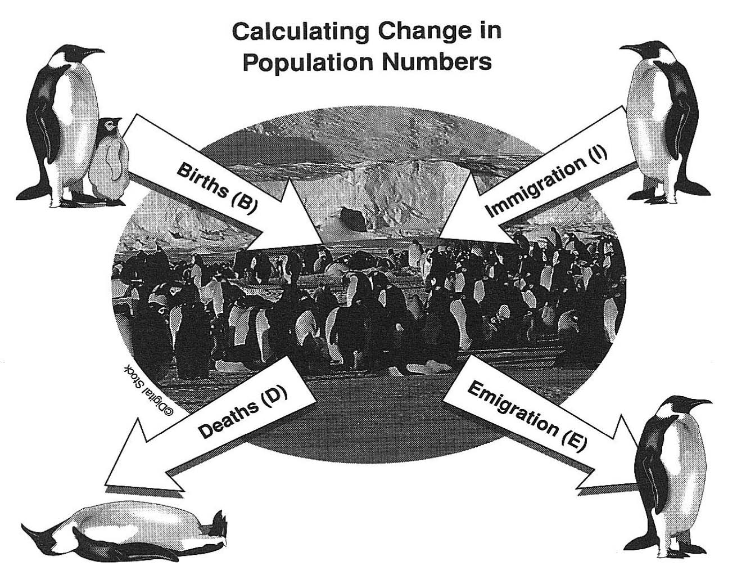
S shaped curve
Once a population has been established then birth and death rates usually affect population growth.
IMMIGRATION and EMIGRATION could also play a part!
What is the difference between emigration and migration?
This S-shaped curve is typical for species colonising new habitats.
Populations enter the death phase if one factor becomes in short supply.

Slide 14
Limiting Population Growth
There are two types of factors that can slow down growth or cause a population crash!
DENSITY DEPENDENT FACTORS
DENSITY INDEPENDENT FACTORS
Effect increases as the size of the population increases!
Factors have the same effect on organisms no matter how many there are!

Slide 15
Density Dependent Factors
Accumulation of toxic waste
Disease
Parasitism
Food supply

Slide 16
Density Independent Factors
Usually sudden or violent abiotic factors
floods
fires
drought
volcanic eruption
earthquakes

