Slide 1
Sampling Strategies and Quadrats
An introduction (or a reminder?)

Slide 2
Sampling strategies
Comparing two different areas that are managed in a different way / have differing environmental conditions / differing human impacts…
Random
Practical application?

Slide 3
Sampling strategies
Or
Systematic
Looking at changes across a habitat i.e. away from a tree / river, up a shore, down a stream…
Practical application?

Slide 4
Transects
Line transect
Or a belt transect
Considerations: Length of transect, width of belt, intervals, number of samples
Either of these could be continuous
Or interrupted

Slide 5
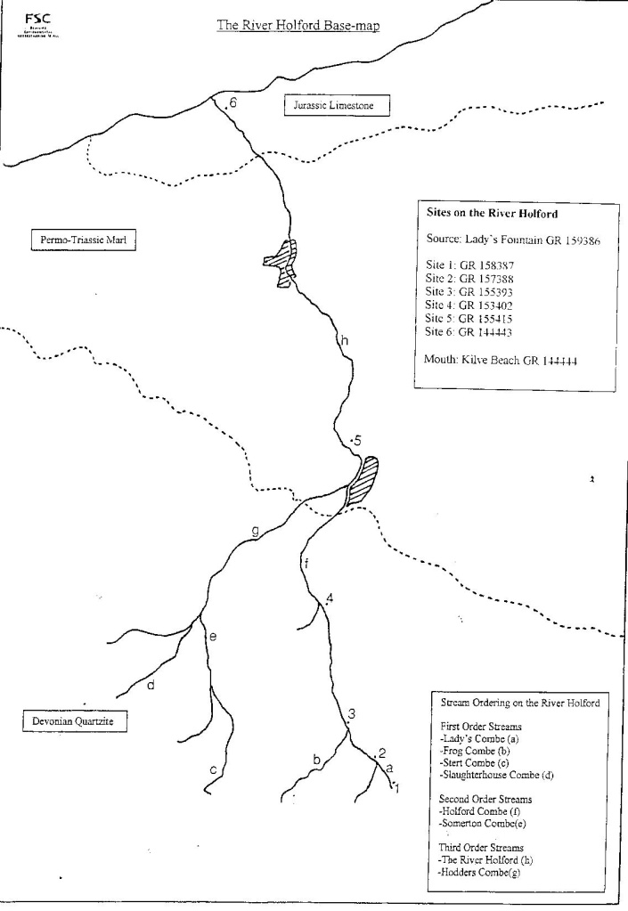
Sampling strategies
Stratified
Often used in conjunction with random or systematic sampling. Considerations: sizes of areas / environments, access, health and safety.
Practical application?

Slide 6
Sutton’s Sortosquarus regulatus
A comparison and evaluation of different methods of measuring abundance of species.

Slide 7
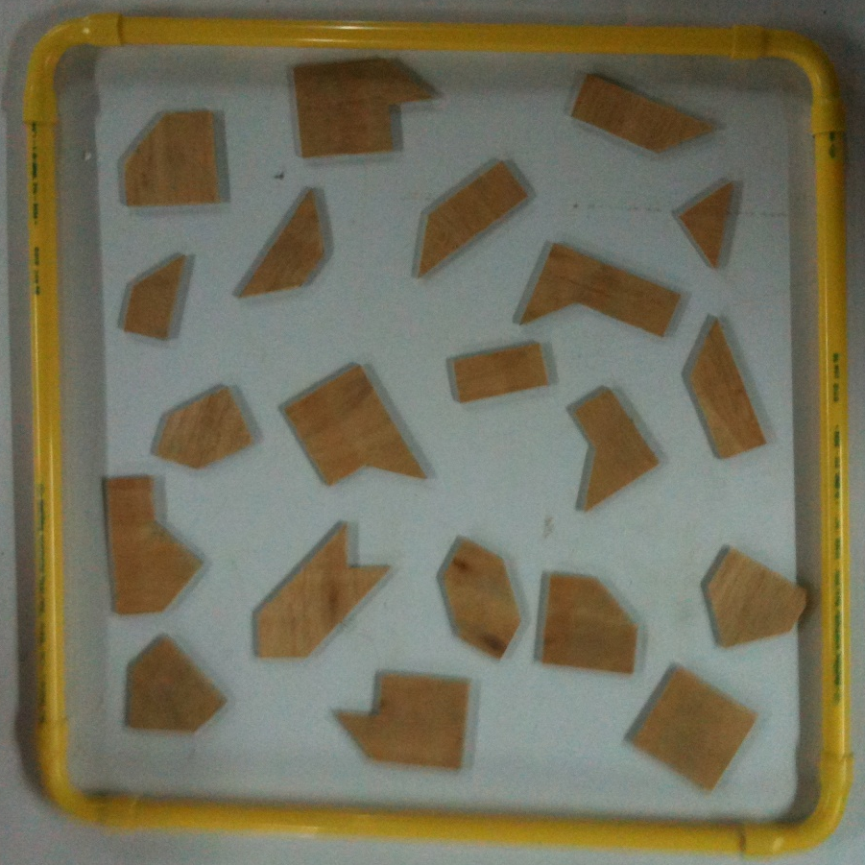
Density
Count the number of individual plants within the open quadrat.
= 21 in 0.5m²
Could scale up
i.e. 84 per m²

Slide 8
Estimate of % Cover
Within the open quadrat estimate the percentage of the area that is being covered by the plant.

Slide 9
Abundance scales
ACFOR Scale:
A = Abundant 80% +
C = Common 60 – 79%
F = Frequent 40 – 59%
O = Occassional 20 – 39%
R = Rare 0 – 19%
DOMIN Scale:
1 < 4%, with few individuals
2 < 4%, with several individuals
3 < 4%, with many individuals
4 4% - 10 % cover
5 11% - 25 % cover
6 26% - 33 % cover
7 34% - 50 % cover
8 51% - 75 % cover
9 76% - 90 % cover
10 91% - 100% cover
Choose an appropriate category for the area that the plant is covering within the open quadrat.

Slide 10
% Frequency
Take a 10cm x 10cm quadrat and a random number table.
Using the random numbers as co-ordinates, place the quadrats with the bottom left hand corner at the co-ordinate.
Record if the species is present or absent.
Repeat to collect 25 samples.
% Frequency = Number present x 100 25

Slide 11
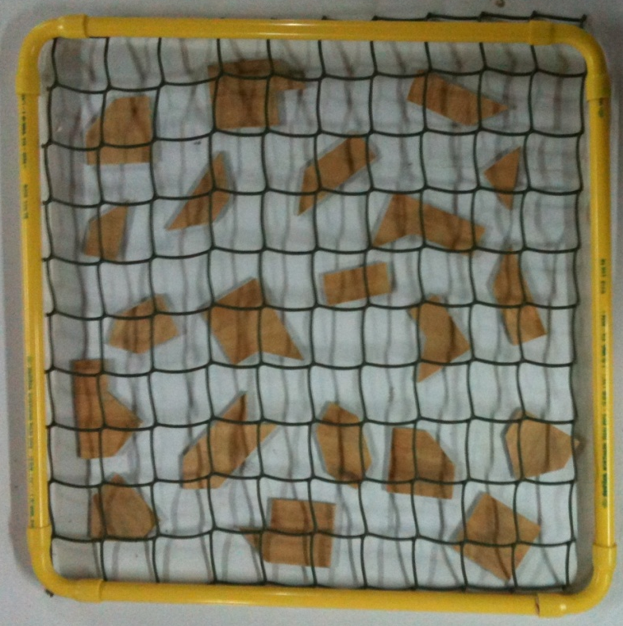
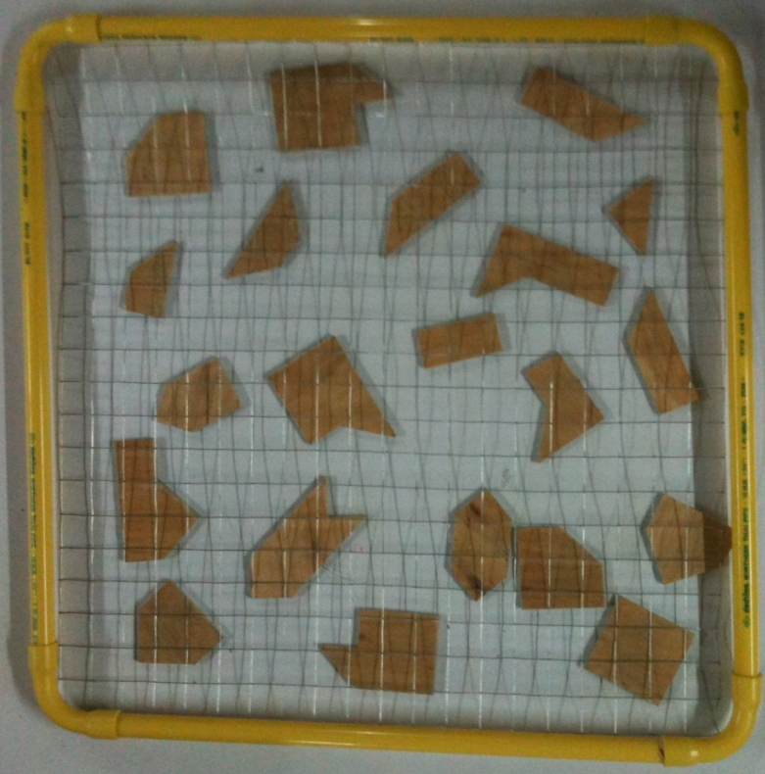
% Frequency
This time, count how many of the squares within the 5cm x 5cm gridded quadrat contain a plant. Again, record presence / absence; count if any part of the plant is in the square.
How does this compare to that of the 25 randomly placed 10cm x 10cm quadrats?
What about having even smaller grids?

Slide 12
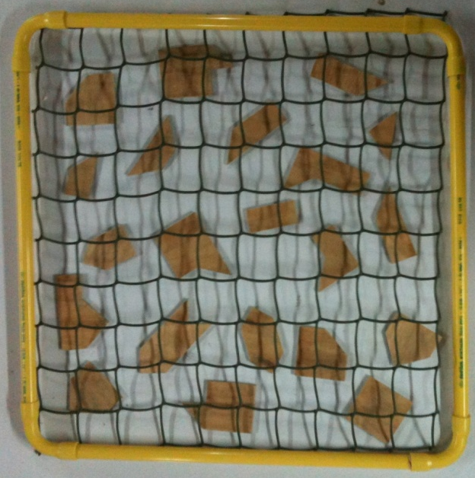
% Frequency
This uses a method called POINT SAMPLING. In every intersection of each square in the 5cm x 5cm square gridded quadrat, use a pencil to see if a plant is present. If it is, count it as a hit, repeat for each square and the total will be a percentage cover of the plant for that quadrat.
% Frequency = Total plants hit x 100 Points dropped

Slide 13
Now fit together the pieces to form a square and measure it.
How does the true value compare to the techniques demonstrated?

