Slide 1
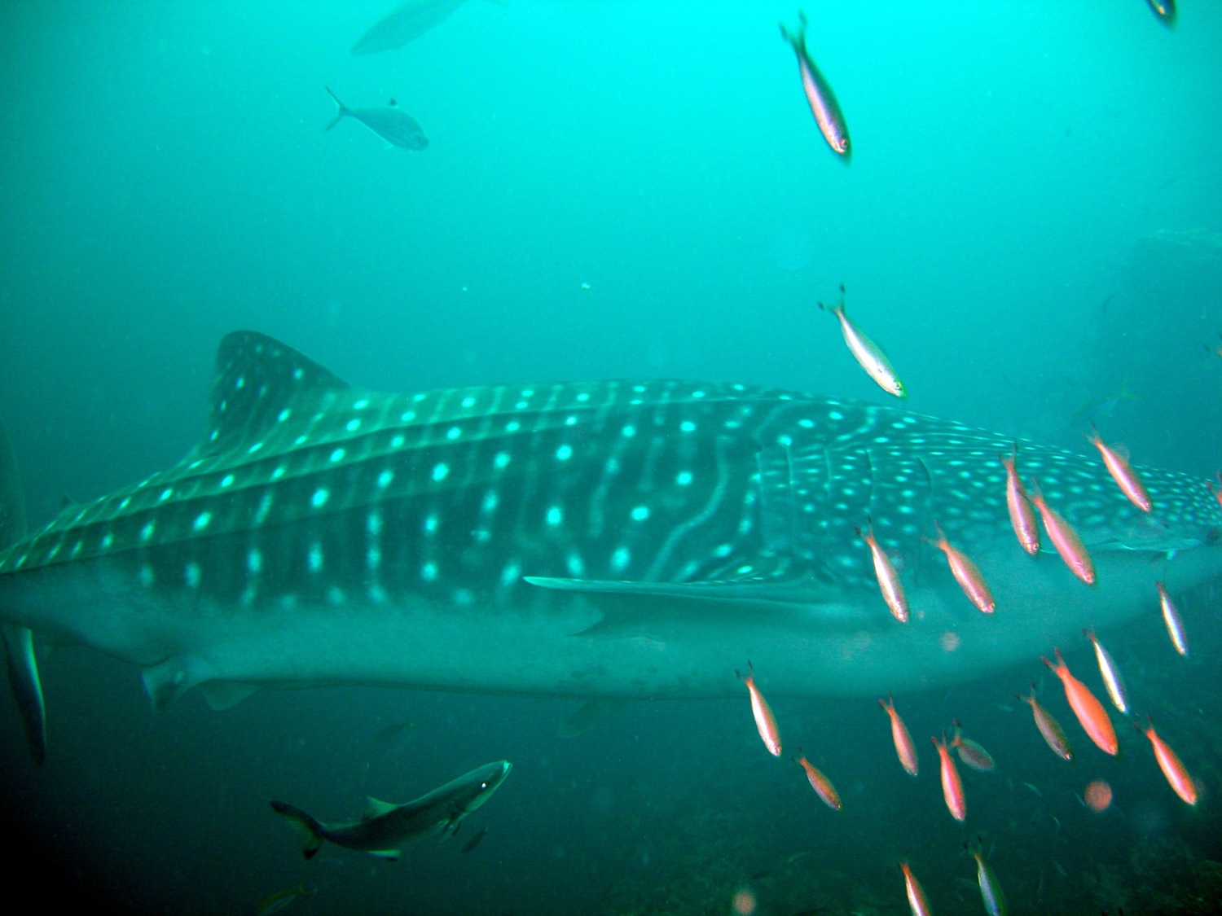
Introduction to Water Systems
Significant ideas:
The hydrological cycle is a system of water flows and storages that may be disrupted by human activity.
The ocean circulatory system (conveyor belt) influences the climate and global distribution of water (matter and energy)
Whale shark (Rhincodon typus) off Din Daeng , Thailand . It is a slow-moving filter feeding shark and the largest known fish species in existence. It follows the warm ocean currents that are rich with plankton.

Slide 2
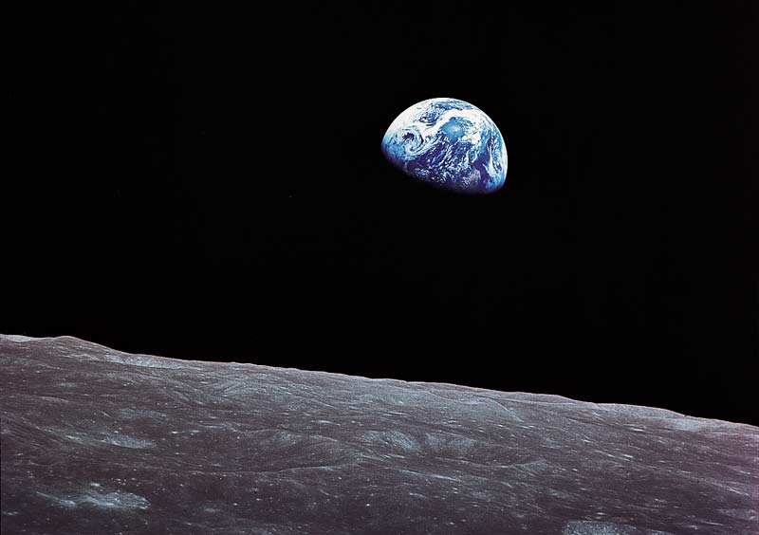
From a distance, the Earth is a blue planet.
70% of the surface is covered with water.

Slide 3
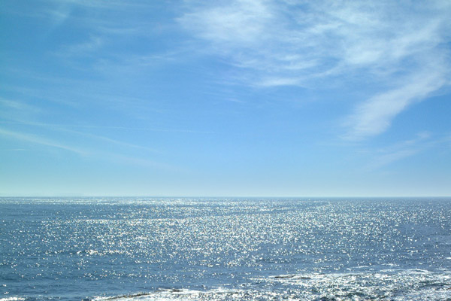
97% of the Earth’s water is salt water Less than 3% is fresh water 66% of all fresh water is trapped in glaciers, icebergs, snow Less than 1% of the fresh water is available for human use

Slide 4
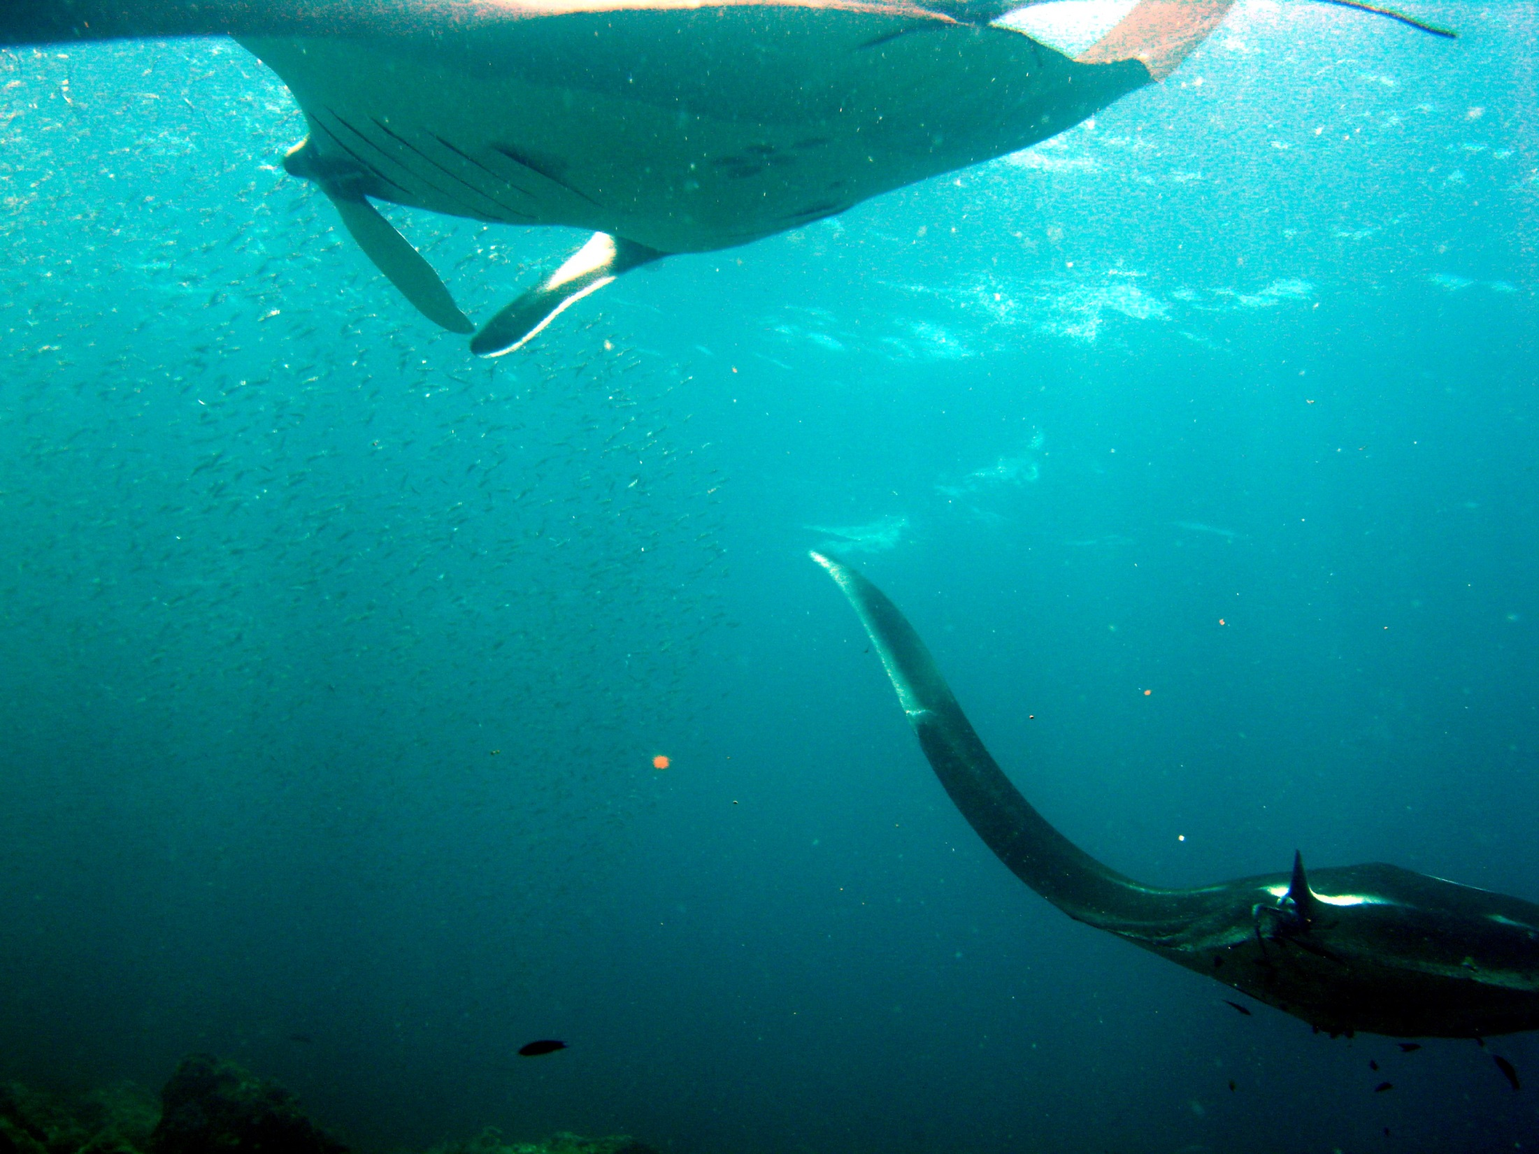
97% of the water on the planet is salt water.

Slide 5
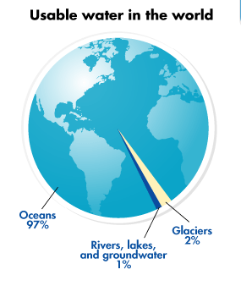

Slide 6
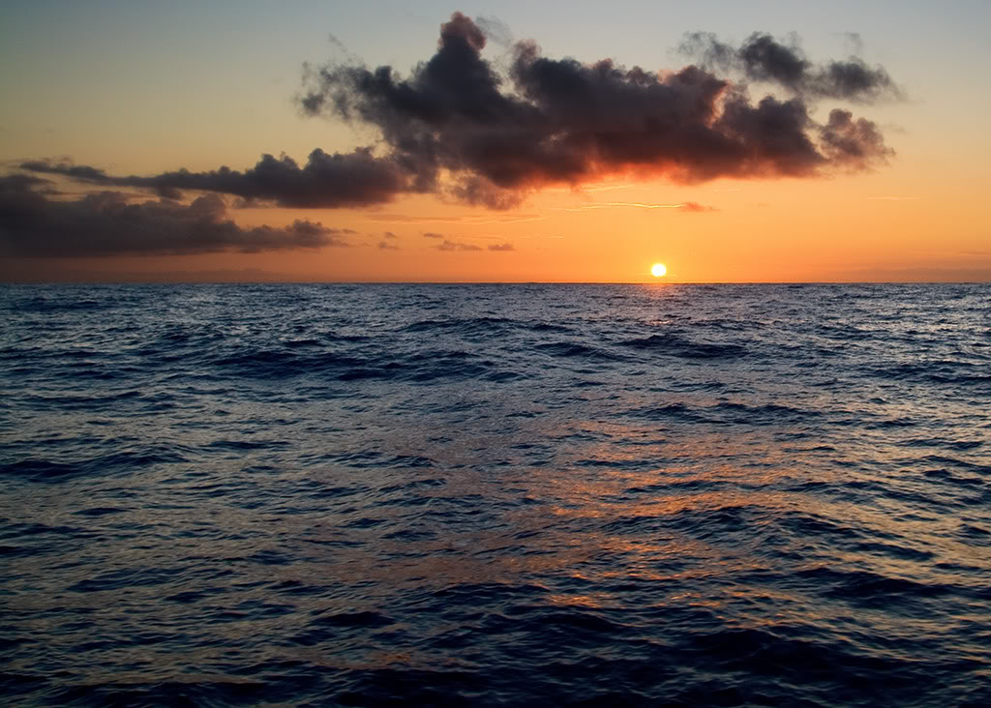
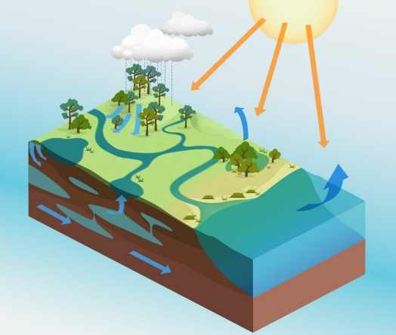
4.1 U.1 Solar radiation drives the hydrological cycle.
Starter:
Using these words to label the water (hydrological) cycle diagram on the worksheet
Highlight the storages and flows in different colours
Ocean
Precipitation
Transport
Evapotranspiration
Melting
Infiltration
Ice and Snow
Groundwater (aquifer)
Lake
Condensation
Surface run-off
Percolation
River Discharge
Evaporation
Stream flow
Advection
Soil
Organisms
Glaciers
Sublimation Freezing

Slide 7
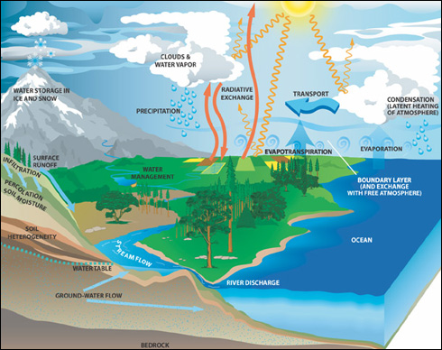
4.1 U.1 Solar radiation drives the hydrological cycle.

Slide 8
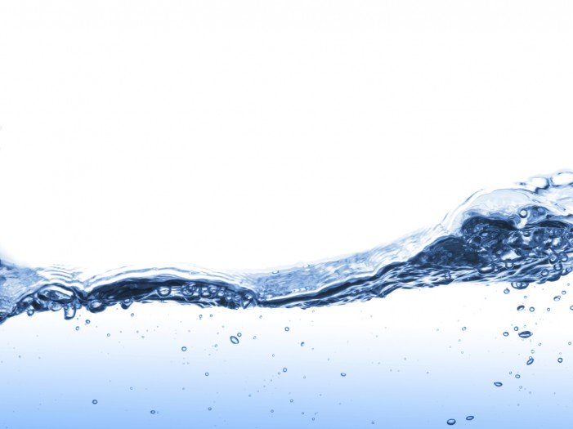
Using the Internet
4.1 U.3 and U.4 Storages and flows
Find out the definitions of the following:
Precipitation
Evapotranspiration
Infiltration
Surface runoff
Groundwater
Percolation
Advection

Slide 9
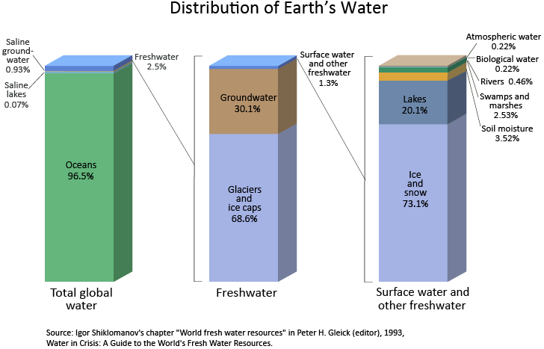
4.1 U.2 Fresh water makes up only a small fraction (approximately 2.6% by volume) of the Earth’s water storages.

