Slide 1
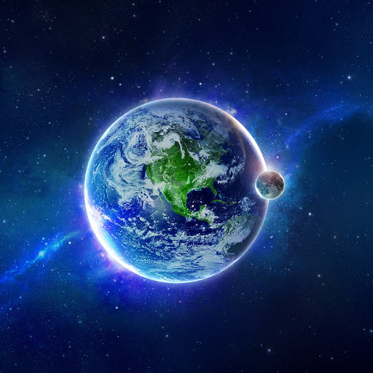
Earth’s Atmosphere
Why is it so important to life on Earth?

Slide 2
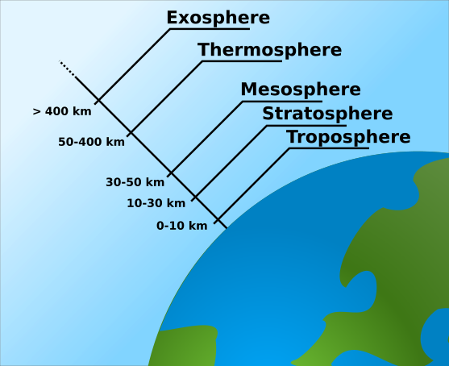
Earth’s atmosphere is made up of 5 different layers…

Slide 3
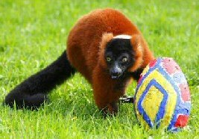
Did you know that The Science Monkey tested eggs?
Say it with me…
The
Science
Monkey
Tested
Eggs

Slide 4
I know you are thinking…what is she talking about???
The
Science
Monkey
Tested
Eggs
MEANS….
Troposphere
Stratosphere
Mesosphere
Thermosphere
Exosphere
THE FIVE LAYERS OF THE EARTH’S ATMOSPHERE FROM THE EARTH OUT!

Slide 5
Why is the atmosphere divided into 5 different layers?
Any guesses?
The atmosphere is divided into five different layers because the atmosphere is not uniform, its properties change with altitude.
Two properties change with altitude, the AIR PRESSURE and the AIR TEMPERATURE
Lets look at each layer individually.

Slide 6
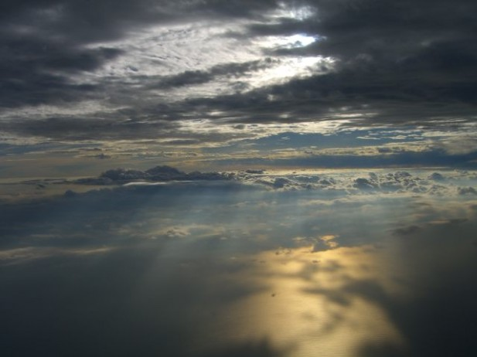
The first layer of the atmosphere is the…
TROPOSPHERE
The troposphere is the layer of the atmosphere nearest to Earth.
The troposphere goes from 0km to 16km.
All weather happens in the troposphere.
More than half the air in the total atmosphere is in this layer.
The temperature drops as the altitude increases.
Harmful ozone is found here…IT CREATES SMOG!

Slide 7
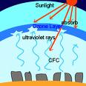
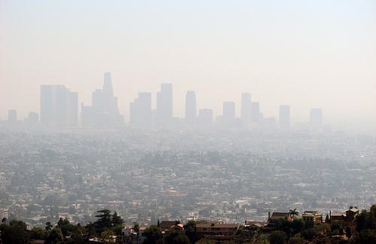
What is OZONE?
A gaseous layer in the upper atmosphere that protects the earth from harmful ultraviolet radiation. At lower levels, ozone becomes a major pollutant.
What is SMOG?
Pollution formed by the interaction of pollutants and sunlight (photochemical smog), usually restricting visibility, and occasionally hazardous to health.

Slide 8
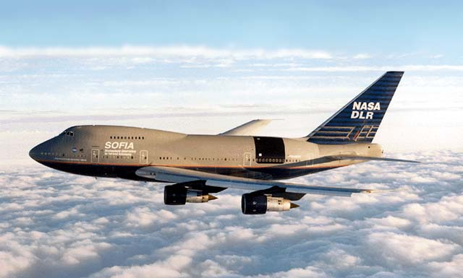
The second layer of the atmosphere is the…
The stratosphere goes from 16km to 50 km.
The temperature goes up with altitude.
Most jets fly in this layer.
The protective ozone is at the top of the atmosphere (It protects us from the ultraviolet radiation of the sun.)
Rivers of air, called Jet Streams, can be found at the base of this layer.
STRATOSPHERE

Slide 9
The third layer of the atmosphere is the…
MESOSPHERE
The Mesosphere goes from 50km to 90km.
In the mesosphere, the temperature drops with altitude.
The mesosphere is the coldest layer of the atmosphere.
Meteors burn up in this layer.
Radio waves are reflected back to Earth in the mesosphere.

Slide 10
The fourth layer of the atmosphere is the…
THERMOSPHERE
The thermosphere goes from 90km to 300km.
In the thermosphere the temperature goes up with altitude.
The thermosphere is the hottest layer of the atmosphere.
Curtains of light called auroras occur in this layer.
The Ionosphere is found in the thermosphere. This is the component of the thermosphere that makes the auroras.

Slide 11
The last layer of the atmosphere is the…
EXOSPHERE
The exosphere is the outermost layer of the atmosphere.
The temperature in the exosphere goes up with altitude.
Satellites orbit earth in the exosphere.

Slide 12
GOOD LUCK!
It is important to understand the different characteristics of the Earth’s atmosphere. As you go through the following slides, challenge your partner to see who can name the correct layer in which each characteristic can be found.

Slide 13
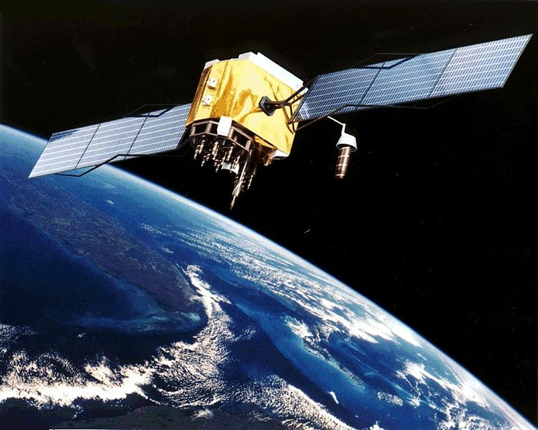
EXOSPHERE

Slide 14
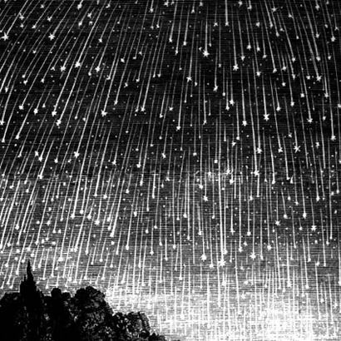
MESOSPHERE

Slide 15
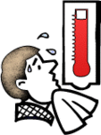
THERMOSPHERE

Slide 16
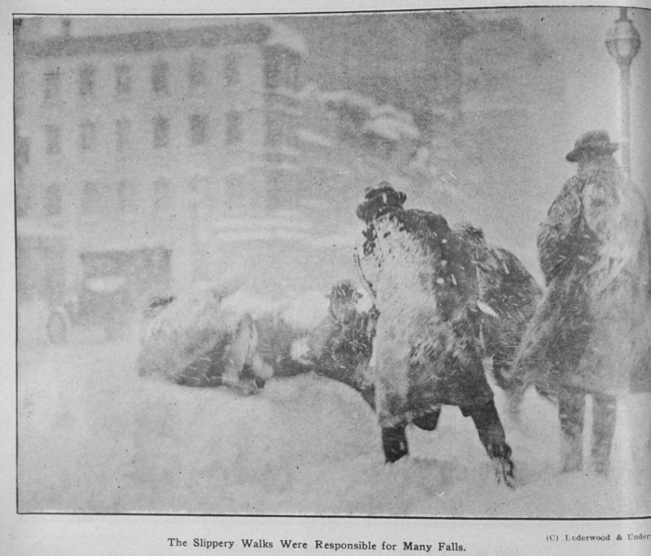
TROPOSPHERE

Slide 17
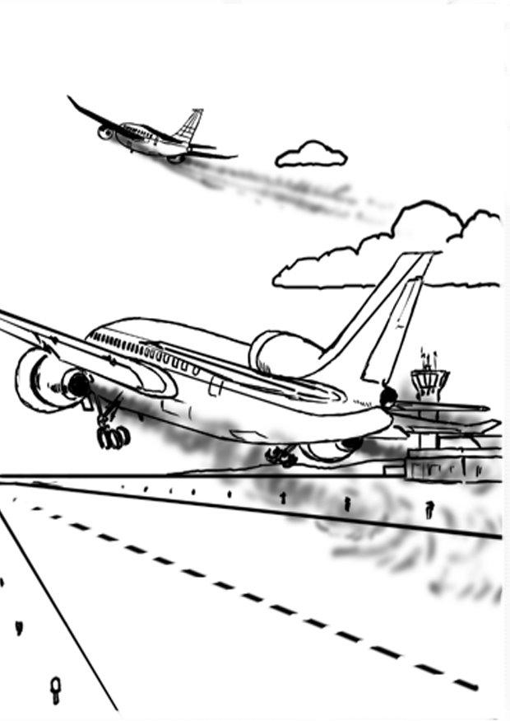
STRATOSPHERE

Slide 18
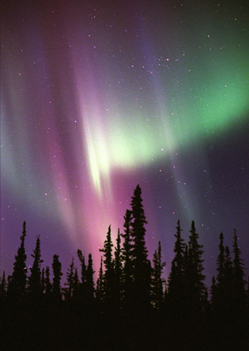
THERMOSPHERE
OR THE IONOSPHERE

Slide 19
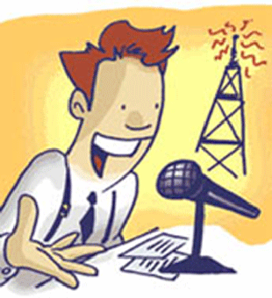
MESOSPHERE

