Slide 1
Biomes of the World

Slide 2
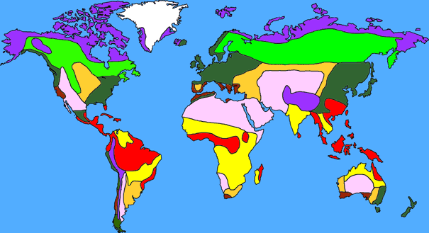
What is a biome?
A BIOME is the largest geographic biotic unit, a major community of plants and animals with similar life forms and environmental conditions.
Notes:
A biome is a large geographic area containing similar plants and animals. This map shows the locations of some of the major biomes of the world.
Each biome can have distinguishing characteristics based on local factors. For example, within the desert biome, there may be hot, cold, and coastal deserts, each with slightly different climates.
It is possible to divide the biomes into smaller units that we call biotic communities, ecosystems, or habitats.

Slide 3
How are biomes formed?
Biomes are distributed across the Earth based primarily on climate. Therefore, in areas that are far apart, you will sometimes find similar plants and animals because the climate is similar.
One factor affecting climate is latitude. Typically, the farther you move north or south of the equator, the colder the temperature gets. Another factor affecting climate is elevation. The higher you go in elevation, the colder the temperature gets.
Biomes usually found at cold latitudes far from the equator are sometimes also found on high mountains at low latitudes. Typically, a climb of 100 feet in elevation is equivalent to traveling 600 miles northward.
Notes:
Climate is a major factor in forming biomes because it is a major factor in controlling which living organisms survive.
Most plants that live in cold climates have developed similar adaptations to the cold, and those adaptations are significantly different from the ones required to survive in warm climates.
As a result, areas with similar climates (on a global scale) have similar biotic communities and are therefore considered the same biome.
Climates change as we move north or south from the equator. As a rule, temperatures drop the farther you get from the equator. Therefore, many biomes are distributed along very distinct lines of latitude. For example, deserts are typically found around 30 degrees North or South latitude.
However, climate can also be affected by elevation. Thus, biomes that are typically found closer to the poles may also be found on mountains located near the equator.

Slide 4
How many biomes are there?
8
Notes:
For purposes of this class, we will consider there to be eight biomes…

Slide 5
How many biomes are there?
Although there is some disagreement among scientists on how to divide up the Earth’s biomes, most can agree on the following eight:
Tropical Rainforest
Tropical Savanna
Desert
Chaparral
Grassland
Temperate Deciduous Forest
Temperate Boreal Forest
Tundra
Notes:
…However, there is some disagreement among scientists about how many biomes there should be. Some argue that there are as few as five and others that there are as many as thirteen or more. For our purposes, we will focus only on the terrestrial (land) biomes. If we included aquatic, there would be even more.
The eight biomes represented here are pretty standard, but they are relatively generic. It is possible to divide these into smaller biomes. For example, we could break the tundra into arctic tundra and alpine tundra.

Slide 6
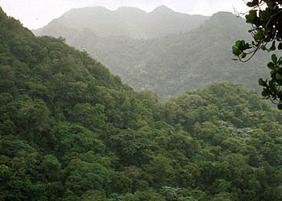
Tropical Rainforest
Typically found near the equator
Receives more than 200 cm of rain annually
Temperatures typically fall between 20ºC and 25ºC for the entire year
As many as 50% of all the world’s animal species may be found here

Slide 7
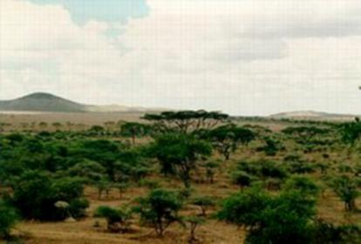
Tropical Savanna
Grasslands with a few scattered trees
Experience a wet and dry season
Hot temperatures
Annual rainfall is between 50 and 127 cm
More species of grazing mammals than any other biome

Slide 8
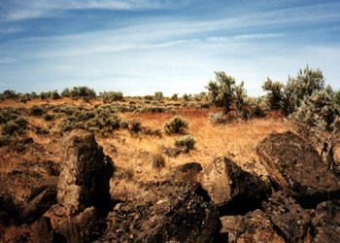
Desert
Typically found between 25º and 40º latitude
Receives less than 25 cm of rain each year
Temperatures typically range between 20ºC and 25ºC but some extreme deserts can reach temperatures higher than 38ºC and lower than –15ºC

Slide 9
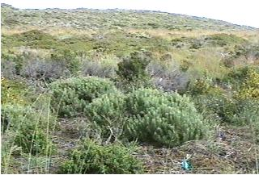
Chaparral
Found between 32º and 40º latitude on the west coast of continents
Receives between 35 and 70 cm of rain, usually in the winter
Extremely resistant to drought and weather events

Slide 10
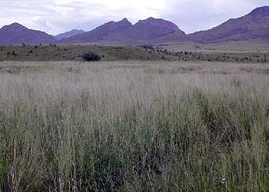
Grassland
Because of the dry climate, trees are found only near water sources such as streams
Usually receives between 50 and 90 cm of rainfall each year
Summer temperatures can reach up to 38ºC, and winter temperatures can fall to –40ºC

Slide 11
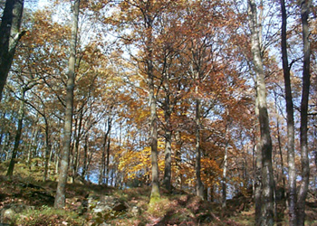
Temperate Deciduous Forest
Moderate climate
Most trees will lose their leaves in the winter
Temperatures range between –30ºC and 30ºC
Averages from 75 to 150 cm of precipitation
Well developed understory

Slide 12
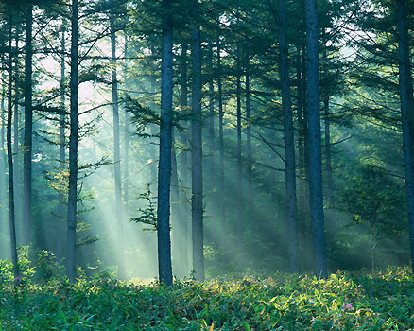
Temperate Boreal Forest
Also known as Taiga
Typically found between 45º and 60º North latitude
Cold climate with summer rains
Very few reptiles
Limited understory
Snow is primary form of precipitation (40 – 100 cm annually)

Slide 13
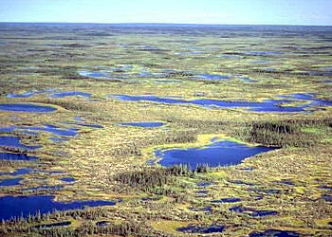
Tundra
Means treeless or marshy plain
Characterized by permafrost – permanently frozen soil starting as high as a few centimeters below the surface – which severely limits plant growth
Winter temperatures average –34ºC while summer temperatures usually average below 10ºC
Low precipitation (15–25 cm per year) but ground is usually wet because of low evaporation

